Slide 1
Core-collapse supernova explosions hindered by eV-mass sterile neutrinos
Kanji Mori
Division of Science, National Astronomical Observatory of Japan
(Moving to Keio University from October)
KM, T. Takiwaki, K. Kohri, & H. Nagakura, PRD 111 (2025) 083046.

Slide 2
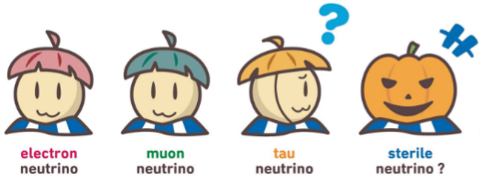
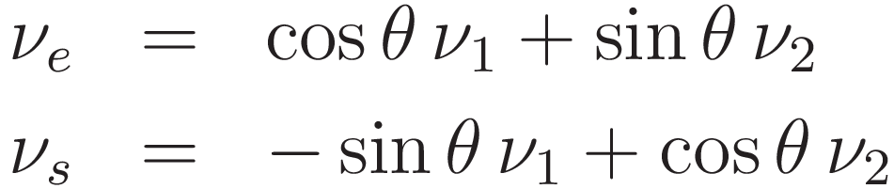
Light Sterile Neutrinos
Hypothetical neutrinos that do not participate in the weak interaction
A possible solution to the reactor antineutrino anomaly
Mixing with active neutrinos
  In this study, we focus on mixing with ν_{e}
ⒸHiggs-tan

Slide 3
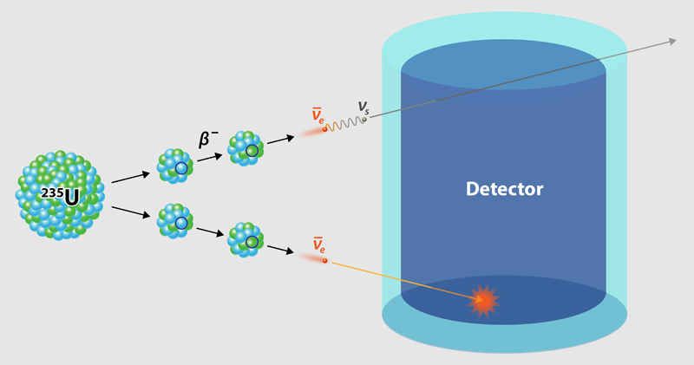
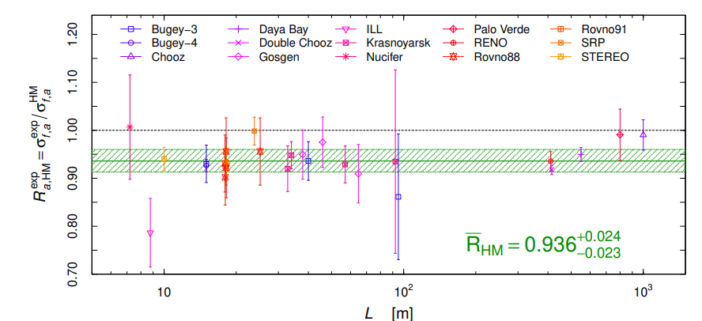
Reactor Antineutrino Anomaly
[Mention et al., PRD 83 (2011) 073006]
https://physics.aps.org/articles/v10/66
2.5σ anomaly
Giunti et al., PLB, 829 (2022) 137054
Deficit in reactor neutrino flux -> A hint of sterile neutrinos?

Slide 4
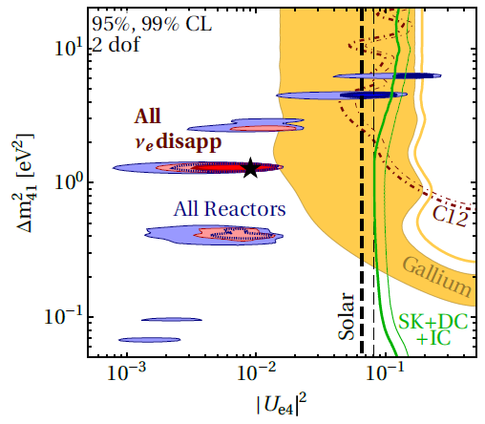
Parameter Space of Light Sterile Neutrinos
Idea: Active-sterile oscillations can happen in SNe as well.
Kainulainen, Maalampi, Peltoniemi, NPB (1991)
Peltoniemi, A&A (1992)
Raffelt & Sigl, Astropart. Phys. (1993)
Nunokawa et al., PRD (1997)
McLaughlin et al., PRC (1999)
Caldwell et al., PRD (2000)
Fetter et al., Astropart. Phys. (2003)
Beun et al., PRD (2006)
Keranen et al. PRD (2007)
Tamborra et al. JCAP (2012)
Wu et al., PRD (2014)
Pllumbi et al. ApJ (2015)
Xiong, Wu, & Qian, ApJ (2019)
Tang, Wang, & Wu, JCAP (2020)
Ko et al., ApJ (2020)
…
Q. How do sterile neutrinos affect SN dynamics?
-> Self-consistent simulations are needed!
Dentler et al., JHEP 08 (2018) 010

Slide 5
Explosion Mechanism of Core-collapse SNe
Core collapse
Core bounce
Shock propagation
~1000 km
~10 km
Shock
ν
ν
Fe
ρ_{c}~3×10¹⁴ g/cm³
Fe
PNS
ν
ν
Bounce shock
~1 s
Neutrino heating is critically important for SNe!
SN explosion
Shock breakout
Shock
~a few days
PNS
PNS

Slide 6
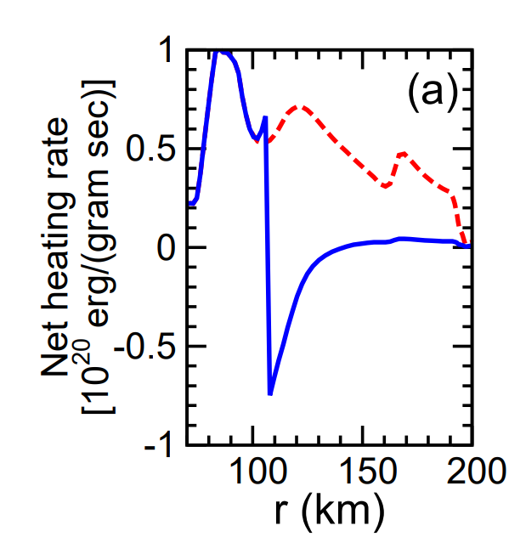
Parameter Space of Light Sterile Neutrinos
w/o ν_{s}
Wu et al.
w/ ν_{s}
Wu et al., PRD 89 (2014) 061303
Neutrino heating rate is significantly reduced.
Dentler et al., JHEP 08 (2018) 010

Slide 7

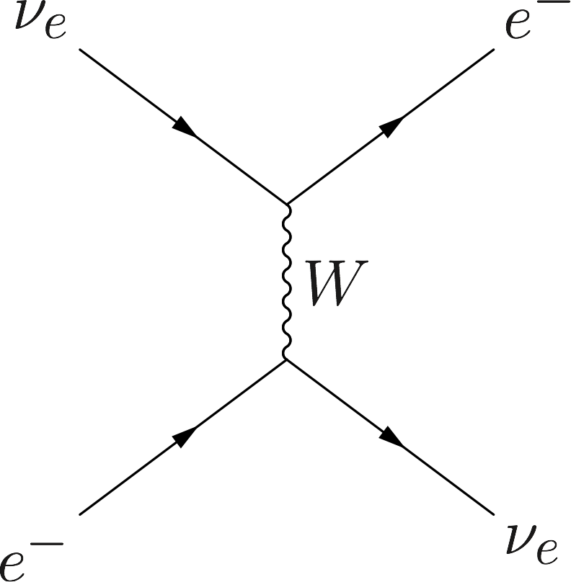
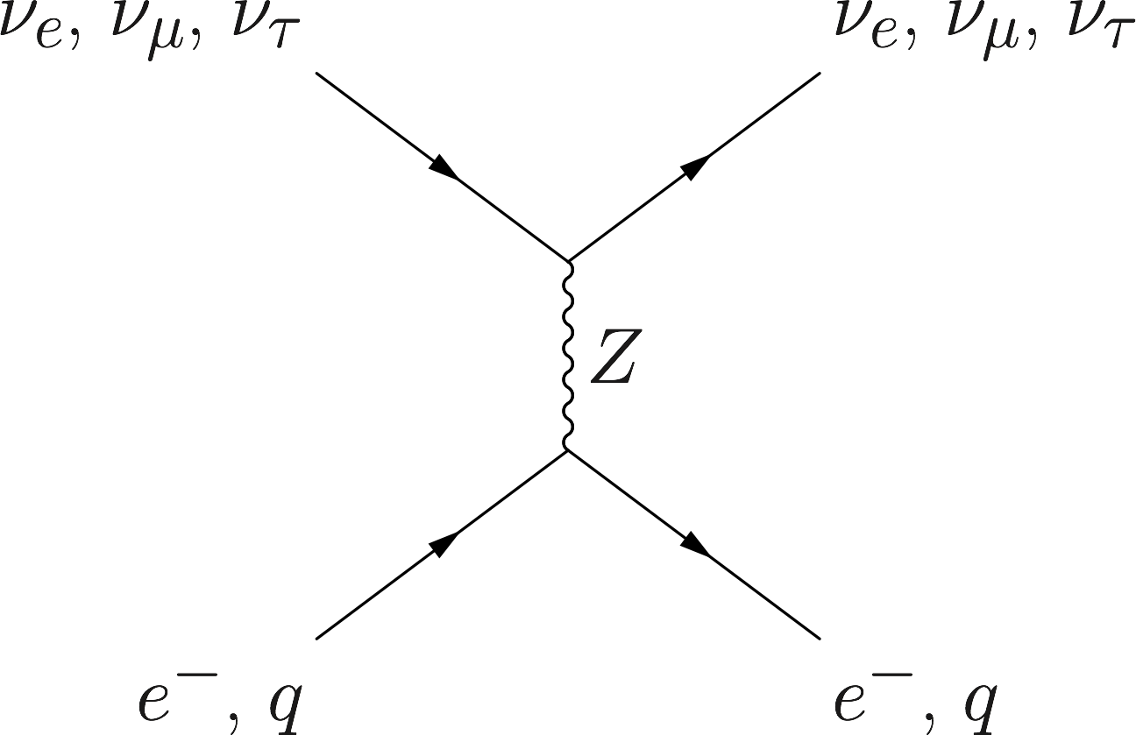
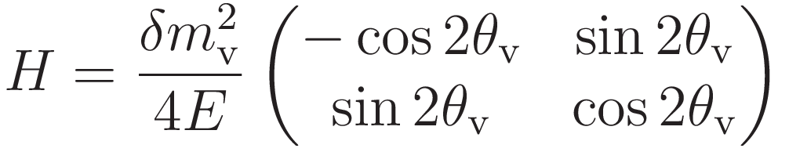
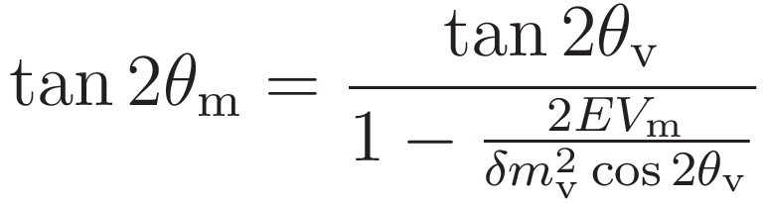
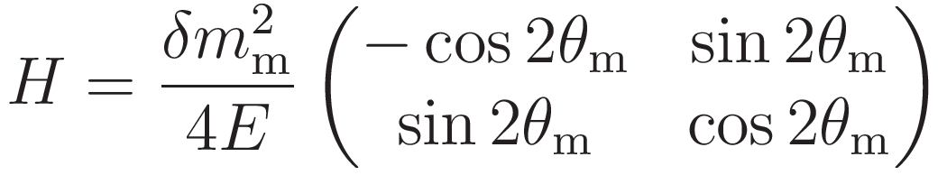
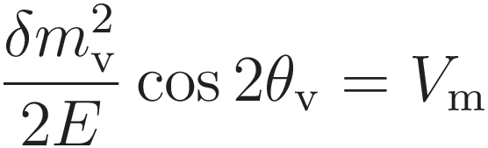
Neutrino Oscillations in Matter
Neutrino oscillations can be described by the Schrödinger-like equation:
Charged current
Neutral current
where the Hamiltonian is
In vacuum
https://docs.neutrino.xyz/matter/index.html
In matter
(V_{m}: Matter potential)
When
is satisfied, θ_{m}=π/4.
→ MSW resonance!

Slide 8
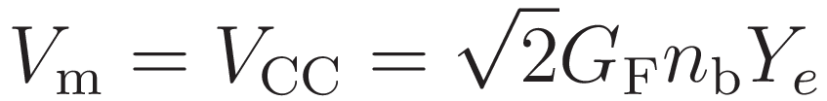
Active-Sterile Oscillations
MSW resonance condition:
 | ν_{e} | ν_{μ,τ} | ν_{s}
CC | ✅ | ✖ | ✖
NC | ✅ | ✅ | ✖
In the case of active-active oscillations,
only the charged-current potential is considered:
However, in the case of active-sterile oscillations,
the neutral-current potential should be included:
(Y_{e c}: electron fraction)
V_{m}
A resonance appears in the post-shock region!
r_{ν}
r_{shock}
(ν_{e})
O
-
Radius
―
(ν_{e})

Slide 9
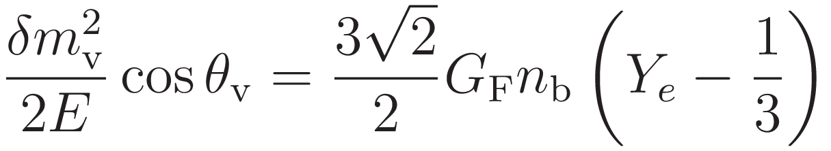

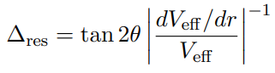

Active-Sterile Oscillations
MSW resonance condition:
m_{V} : ν_{s} mass
θ_{V} : ν_{e}-ν_{s} mixing angle
G_{F} : Fermi coupling
Y_{e} : electron fraction
n_{b} : baryon number density
Bounce shock
MSW resonance
Ye~1/3
The conversion prob. is given by the Landau-Zener formula
ν-sphere
ν_{e}
ν_{μ, τ}
ν_{e}
Since the outer resonance is located at r>1000 km,
we only consider the inner resonance in the simulations.
ν_{s}

Slide 10
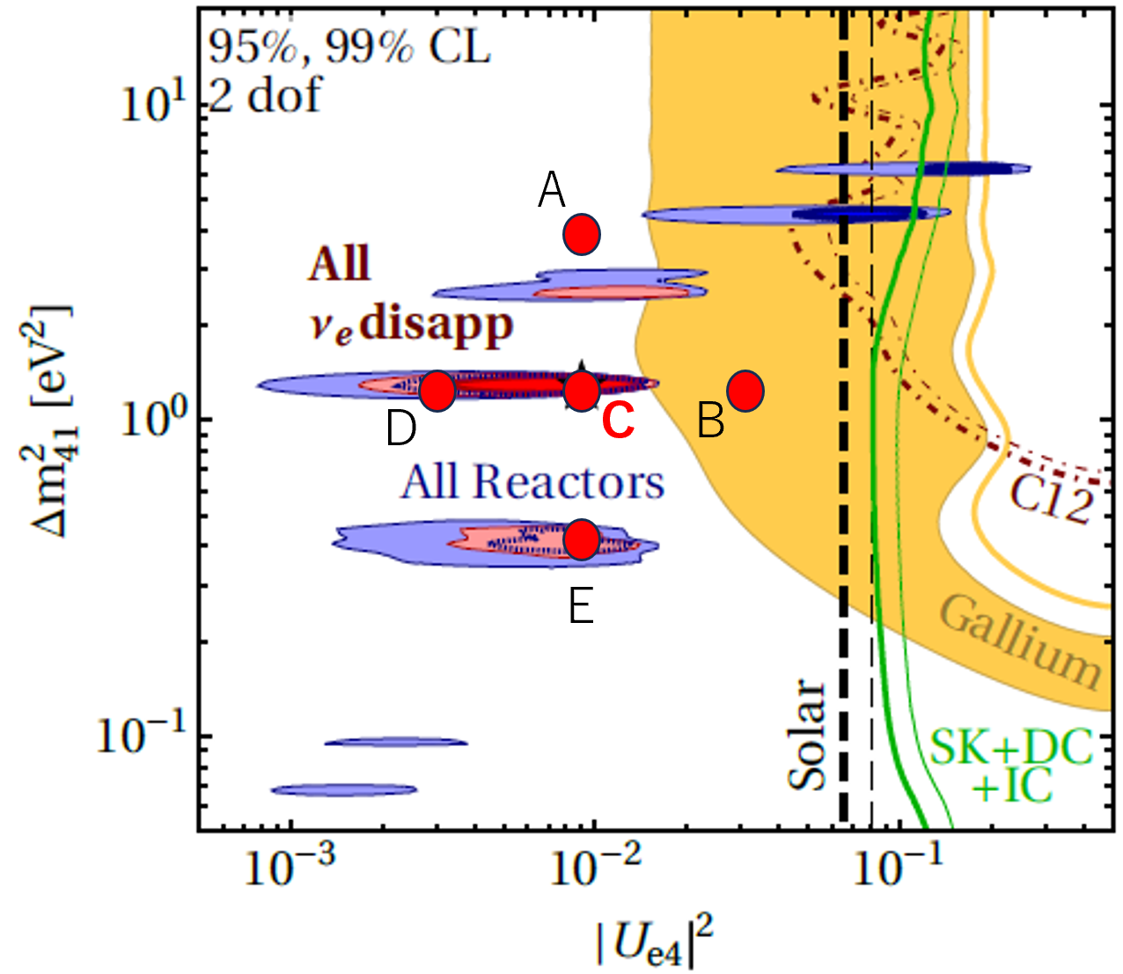
SN Simulation Coupled with ν_{s}
Code: 3DnSNe [Takiwaki, Kotake & Suwa MNRAS 461 (2016) L112]
Neutrino transport: IDSA [Liebendörfer, Whitehouse, & Fischer ApJ 698 (2009) 1174]
Dimension: 2D EoS: LS220 Progenitor: 14+9M☉ merger model
“SN 1987A progenitor model”
ν_{s} mass and
ν_{e}-ν_{s} mixing angle:
[Urushibata et al., MNRAS 473 (2018) L101]
Dentler et al., JHEP 08 (2018) 010

Slide 11
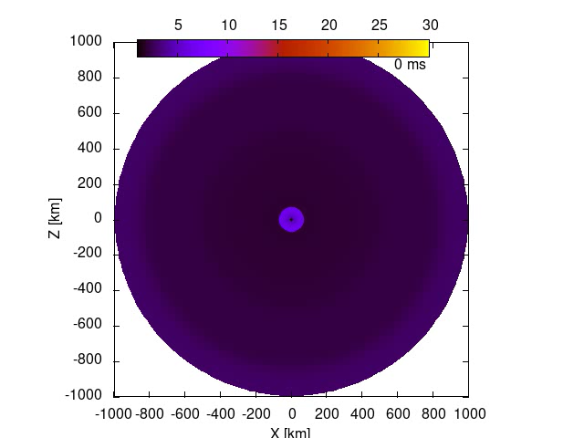

Model A
(δm²=3.90 eV², sin² 2θ=0.040)
Model NoSterile
Sterile neutrinos hinder SN explosion!

Slide 12
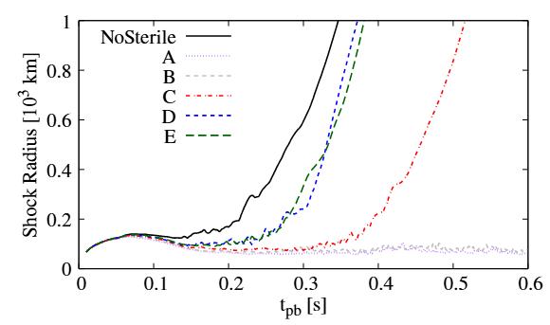

Shock Radius
Successful explosion
When sterile neutrinos are considered, the shock revival is delayed.
When is sufficiently large, the shock is not revived until the end of the simulations.
Failed explosion
KM, Takiwaki, Kohri, & Nagakura, PRD 111 (2025) 083046.

Slide 13
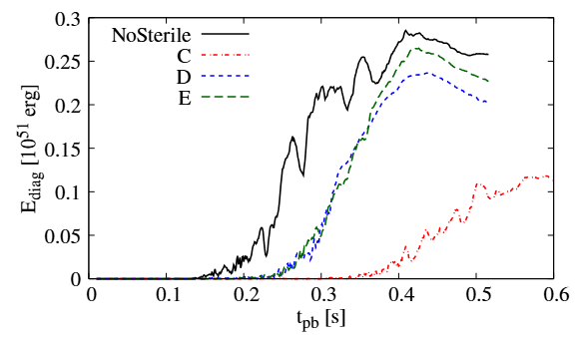

Explosion Energy
KM, Takiwaki, Kohri, & Nagakura, PRD 111 (2025) 083046.
When sterile neutrinos are considered, the explosion energy is reduced.

Slide 14
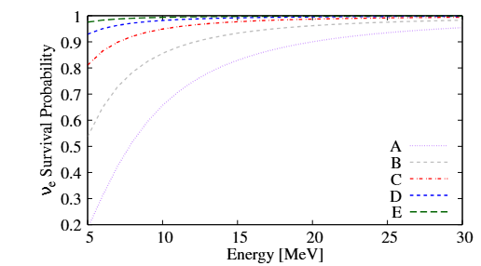
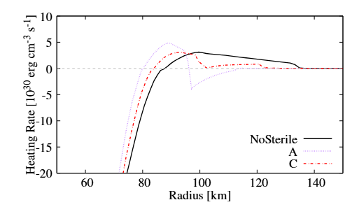
Active-Sterile Oscillation
small
t_{pb}=50 ms
t_{pb}=100 ms
large
KM, Takiwaki, Kohri, & Nagakura, PRD 111 (2025) 083046.
The ν_{e} survival prob. depends on
The neutrino heating rate is reduced!

Slide 15
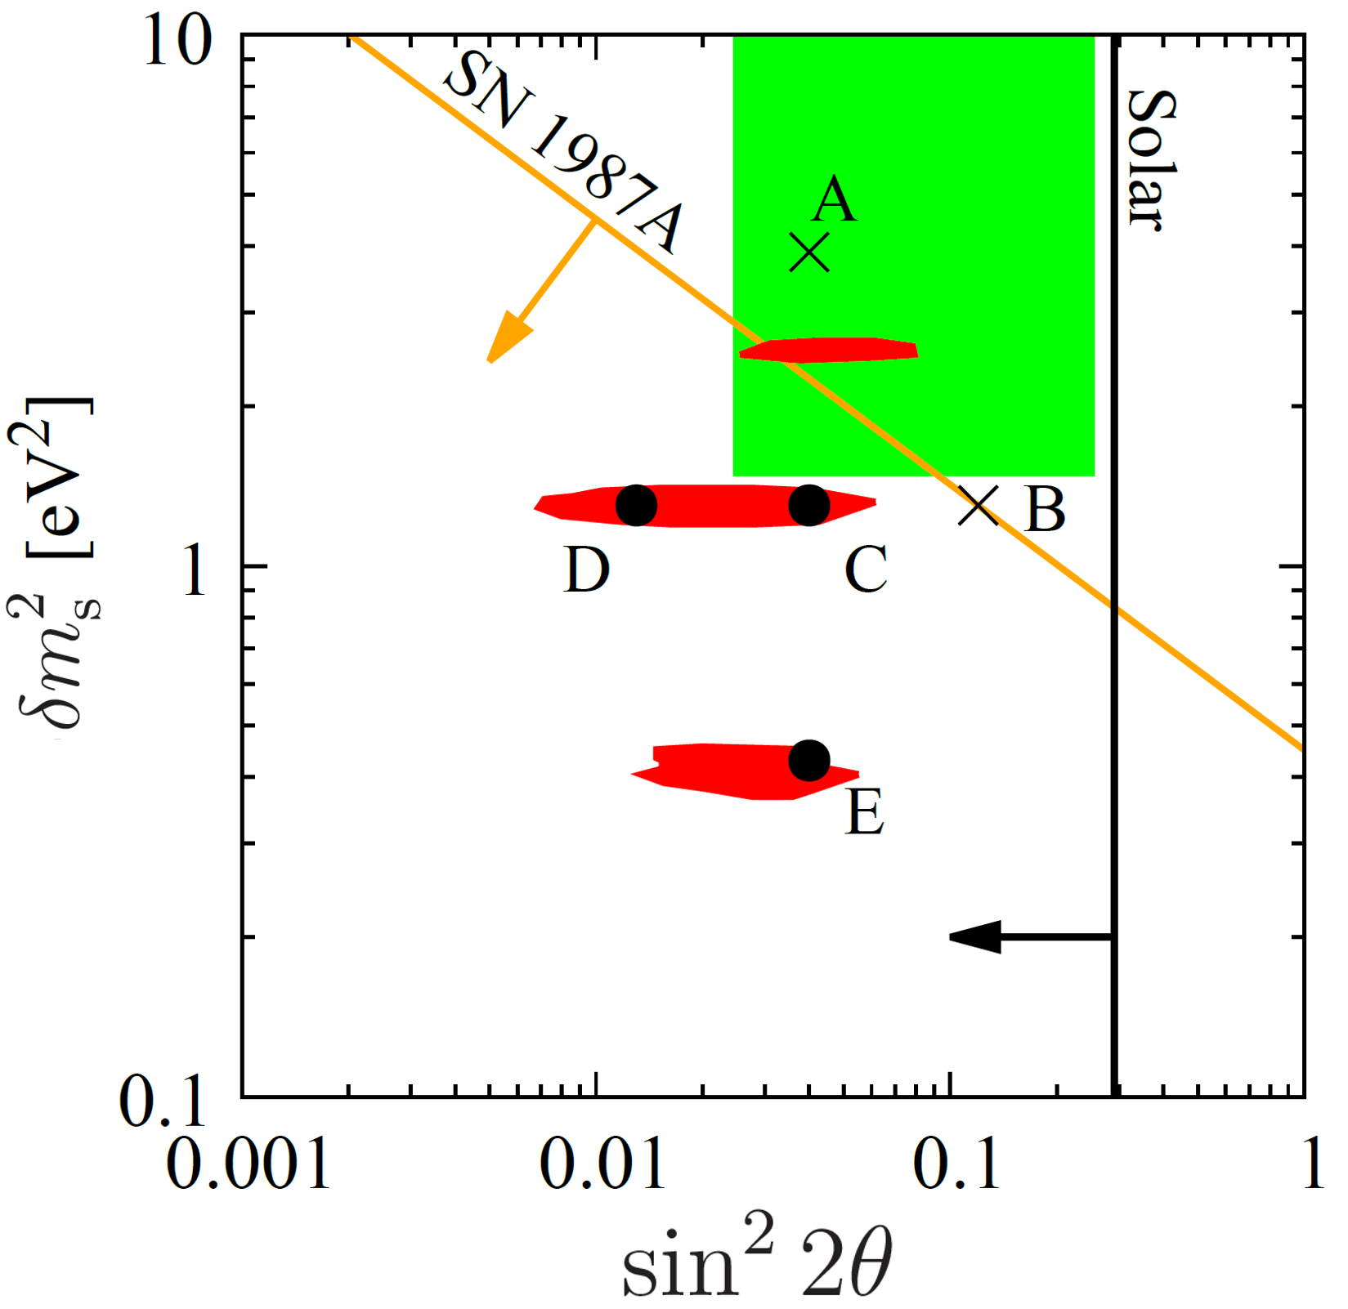

SN 1987A Explosion Condition
Reactor Anti-ν Anomaly
Condition for successful SN 1987A explosion:
Successful explosion
SN explodability can provide a new constraint on sterile neutrinos!
A wide range of the area preferred by the reactor anomaly is excluded
ν_{e} disapp. exp.
×: Failed explosion
: Successful explosion
KM, Takiwaki, Kohri, & Nagakura, PRD 111 (2025) 083046.

Slide 16
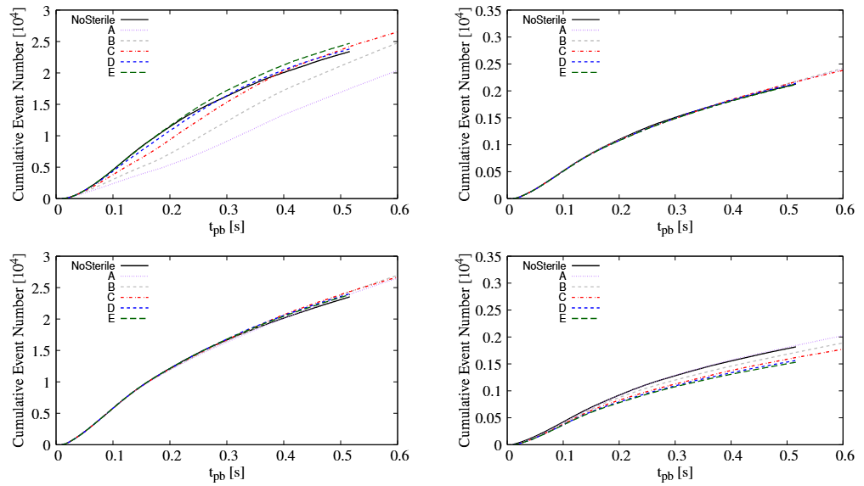
Neutrino Signals
-
D=10 kpc
Hyper-Kamiokande (ν_{e} events)
DUNE (ν_{e} events)
small
large
Normal hierarchy
Normal hierarchy
Observations of SN ν_{e} is useful to probe ν_{s} with a small mixing angle!
(as long as the outer resonance is adiabatic)
large
small
Inverted hierarchy
Inverted hierarchy

Slide 17
Active-Sterile Oscillations
MSW resonance condition:
 | ν_{e} | ν_{μ,τ} | ν_{s}
CC | ✅ | ✖ | ✖
NC | ✅ | ✅ | ✖
In the case of active-active oscillations,
only the charged-current potential is considered:
However, in the case of active-sterile oscillations,
the neutral-current potential should be included:
(Y_{e}: electron fraction)
V_{m}
Adiabatic resonance
→Flavor swap
A resonance appears in the post-shock region!
r_{ν}
r_{shock}
(ν_{e})
O
-
Radius
―
(ν_{e})

Slide 18
Summary
Reactor Anti-ν Anomaly
Light sterile neutrinos (m_{s}~1 eV) would hinder SN explosion.
A new constraint can be obtained based on explodablity.
ν_{e} signals from a nearby SN would provide a stringent constraint on sterile neutrinos.
Successful explosion
ν_{e} disapp. exp.
KM, Takiwaki, Kohri, & Nagakura, PRD 111 (2025) 083046.

Slide 19
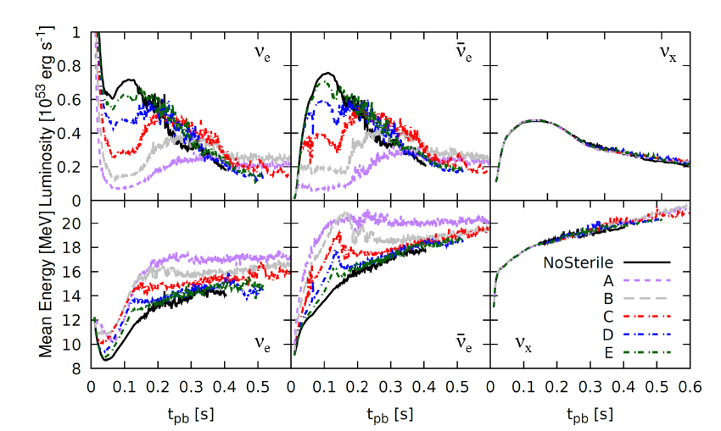
Neutrino Luminosity

Slide 20


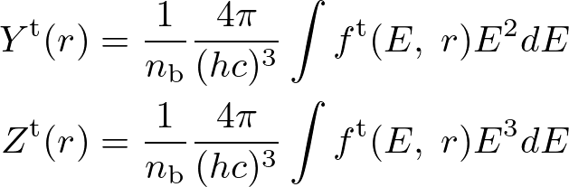

SN Simulation Coupled with ν_{s}
Instantaneous flavor conversion would overestimate ν_{s}!
In our setup,
We employ the BGK prescription for relaxation:
[Bhatnagar, Gross, & Krook, PR 94 (1954) 511.]
[Nagakura, Johns, & Zaizen, PRD 109 (2024) 083013.]
where fª is the asymptotic distribution
In the IDSA, the neutrino distribution is decomposed as
We also consider the feedback on
: ν_{e} number density
: ν_{e} energy density
Trapped neutrinos

Slide 21
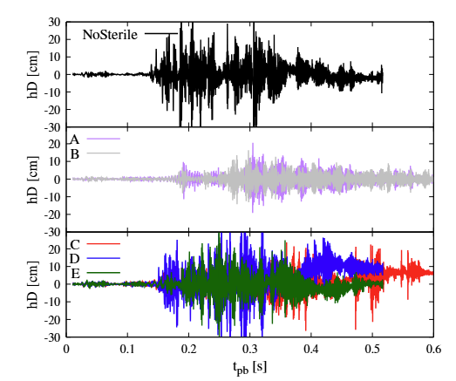
Gravitational Waves

