Slide 1
Puzzles with Vortex Holographic Renormalization
Kai Shi with Prof. Ruth Gregory
New Insights in Black Hole Physics from Holography, Madrid
Notes:
Thanks organizers for invitation.

Slide 2
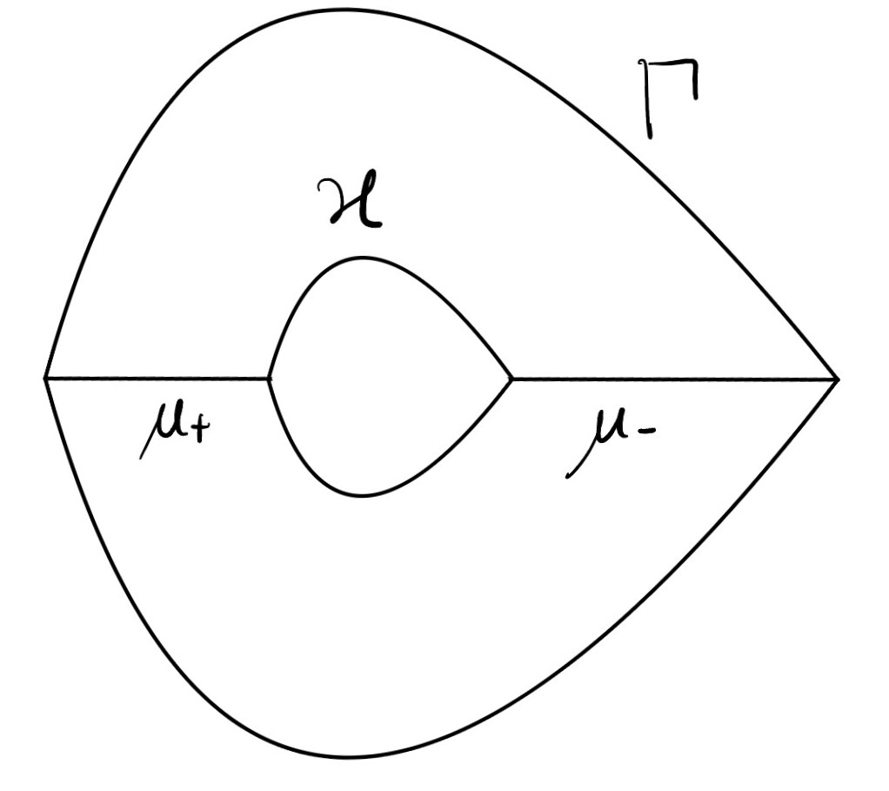
Accelerating black hole suspended by cosmic strings.
Notes:
what is an acc BH, thermodynamics with tension. Bigger font

Slide 3
AdS4-Acc-BH described by C-metric
m: mass of black hole
e: electric charge of black hole
A: acceleration of black hole
K: total conical factor
$α$: time rescaling parameter
Physical Review D, 34(8):2263–2266, oct 1986.
Phys. Rev. D, 52:5598–5604, Nov 1995.
10.1007/JHEP05(2017)116
Notes:
Ruth said 3d and acceleration, me 4d this is a brief introduction; \Omega, m, e, \alpha.

Slide 4
Imbalanced Conical deficit
Accelerating black hole suspended by cosmic strings.
10.1103/PhysRevD.2.1359
10.1103/PhysRevD.52.5598
Notes:
Angular part, conical deficit, sourced by string tension, thermal length.

Slide 5
Motivation: Improved thermodynamics?
Eur. Phys. J. C (2023) 83:1095
? mass inconsistency
? Integrability of first law
*conical singularity on boundary*
Improve renormalization
Notes:
Story not complete, thermodynamics need to be improved.
P:Kormar mass, N:Hamiltonian
Variational Principle, alpha is not freely chosen as function of other parameters, loss of integral form of thermodynamics
both problems are attributed to the renormalized action.
No regularization of conical singularity on boundary.
In previous paper, we don’t know how to calculate the holographic mass, so there is an inconsistency in the definition of it; nonintegrablility of the thermos first law.

Slide 6
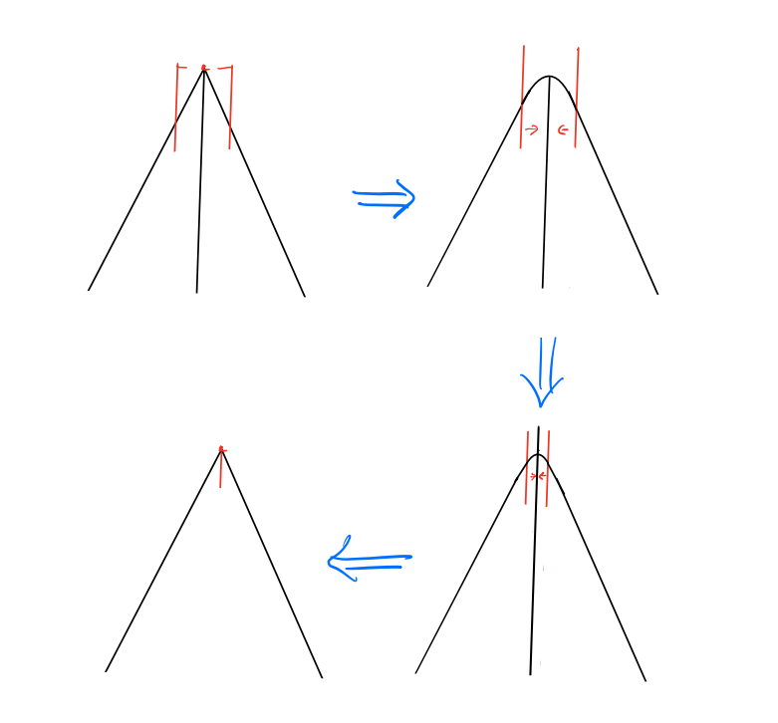
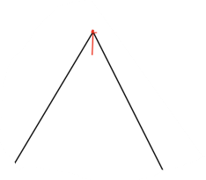
Geometric regularization
10.1103/PhysRevD.52.2133
$$u=1$$
Notes:
Formal procedure
4 steps,
Works well for bulk,
2 regulators, decouple

Slide 7
Puzzle: regularize conical singularity on boundary
Naively:
$$ε:distance$$
$$w: width$$
Notes:
2 regulators, 2 procees. If 1, if 2.

Slide 8
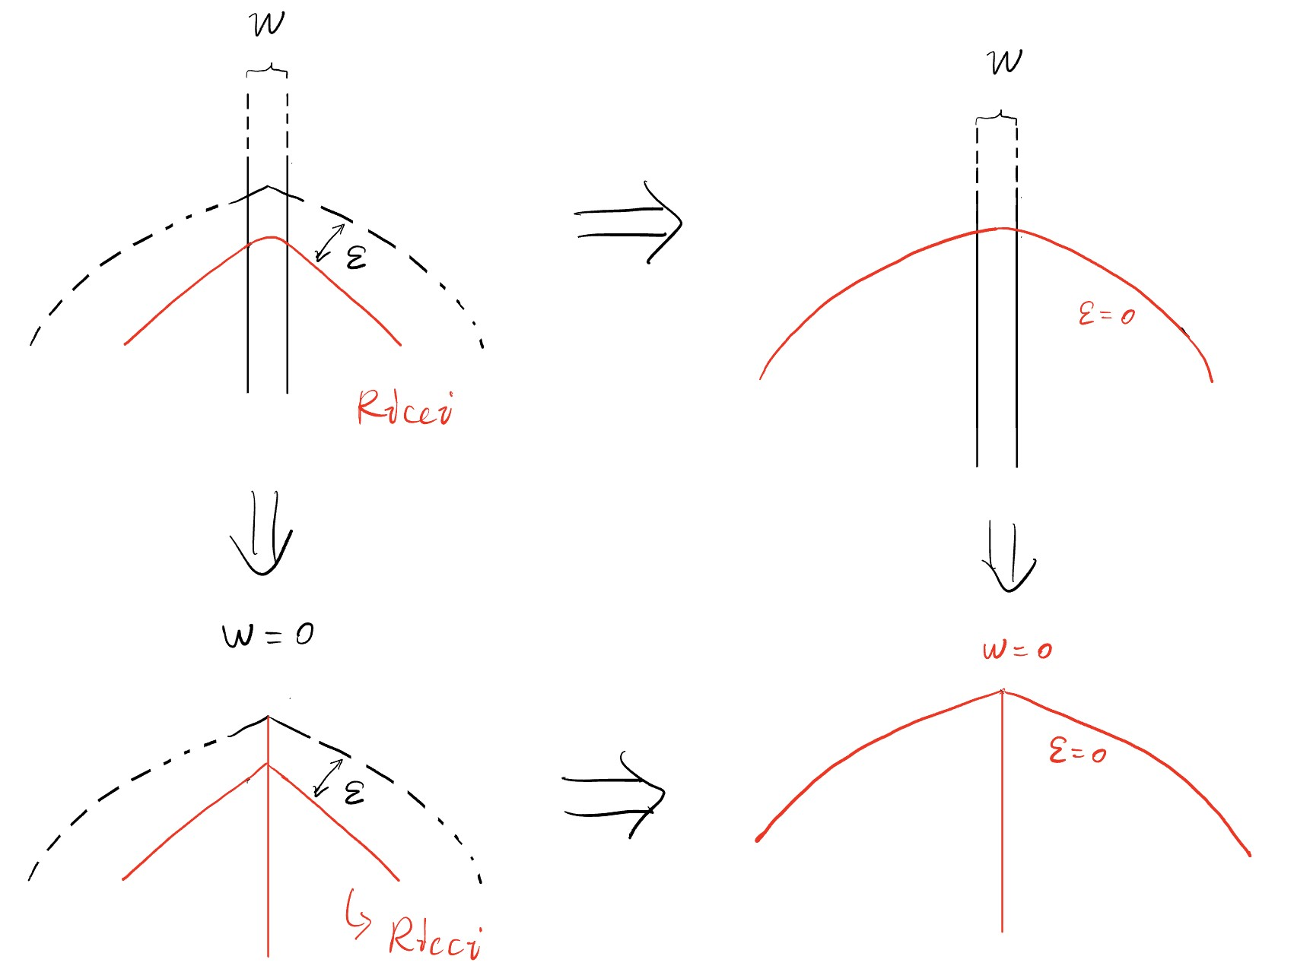
Puzzle
- extra terms?
$$ε:distance$$
$$w: width$$

Slide 9
This extra term matters!
Finite, goes into first law.
The FG expansion of regulated C-metric is peculiar:
$g_{ij}^{(1)}$ is sourced by $u(θ), A$together; $u(θ\left(ε,x\right)),$mixing regulators.
Notes:
Deviation from the usual FG expansion, our puzzle is very specific, A,u both exist. Key message: g^1_ij due to the mixing of 2 regulators; we are working on the modified thermodynamics; understanding new phenomena, we have written down the results.

Slide 10
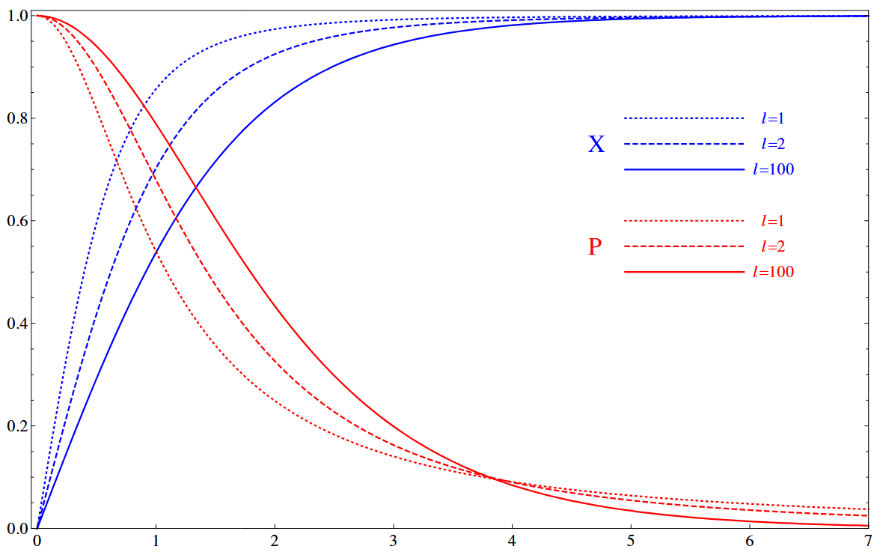
Take a step back: Nielsen-Olsen vortex in AdS4
$X\left(R\right),P\left(R\right)$ of AdS NO vortex
Notes:
Ignore the details of string, higher resolution model.
NO vortex: vortex solution,

Slide 11
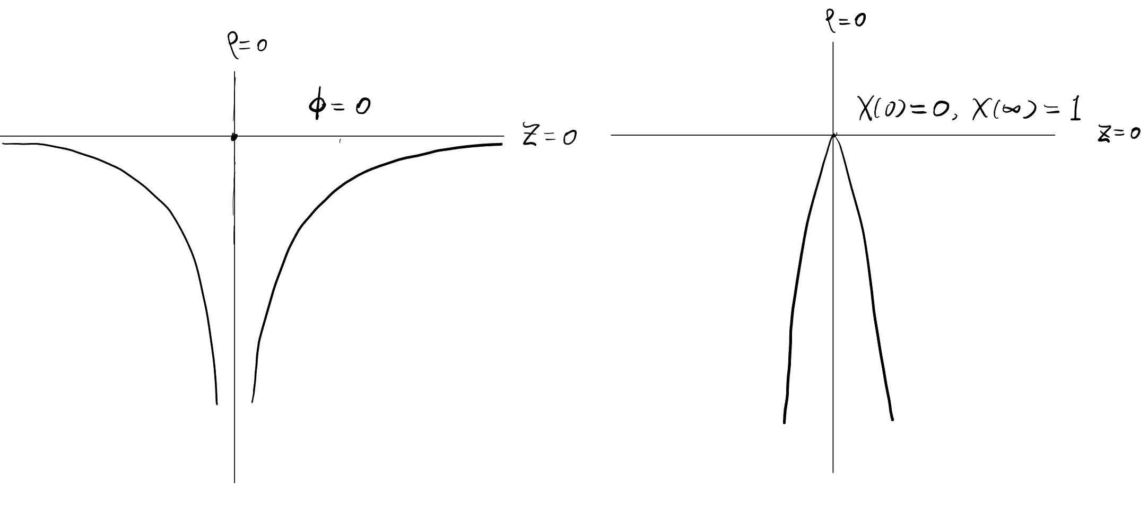
Difference from the usual holographic vortex
Superconductor
Vortex
NO vortex
Contour of constant value of scalar $φ(ρ),X(ρ)$ near the boundary of Poincare patch.
$$S_{onshell}∝\frac{1}{z^{n}}$$
$$X≠∑z^{n}X_{n}(ρ)$$
Notes:
Compare 2 vortex. No! not the same as the usual vortex. Approach to the boundary. On the boundary.
No trivial Taylor expansion, can’t immediately see the divergent behaviour by counting $z^{−n}$. Therefore, usual holographic renormalization procedure does not apply.

Slide 12
Outlook
Regularize NO vortex in AdS background.
$$S_{ren}=S_{onshell}+ct(X,P)$$
Include backreaction.
Uplift to C-metric, cross check with the extra term in geometric regularization and understand it better.

Slide 14
Regularization condition
Smoothed region zero width

Slide 15
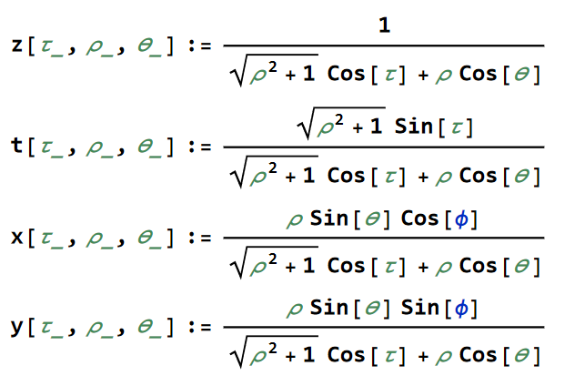
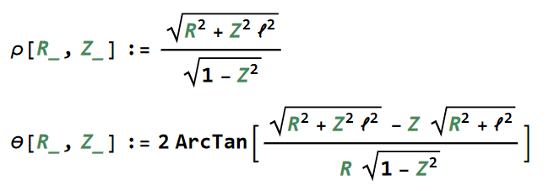
AdS4 vortex width in Poincare coordiante

