Slide 1
Gravitational Duals from Equations of State
Pedro Tarancón-Álvarez
New Insights in Black Hole Physics from Holography
Instituto de Física Teórica (IFT), Madrid
19/06/2025

Slide 2
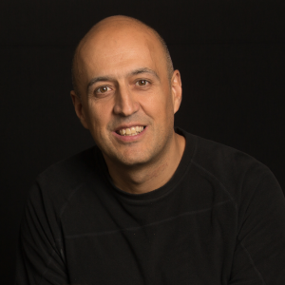
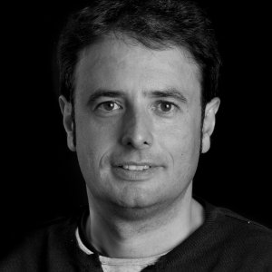
The People
Based on:
Gravitational duals from equations of state
2403.14763 [hep-th], 10.1007/JHEP07(2024)087
Raul Jiménez
(ICREA & UB)
Yago Bea
(UB)
David Mateos
(ICREA & UB)
Shuheng Liu
(Harvard U.)
Pavlos
Protopapas
(Harvard U.)
Pablo Tejerina
Pérez (UB)
Pau Solé Vilaró
(UB)

Slide 3
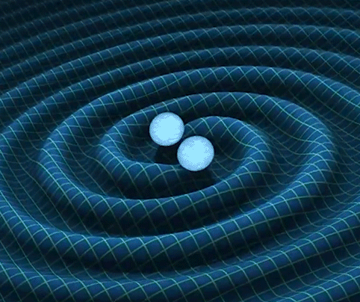
New windows to the universe
[LIGO & VIRGO C. 2016]
Strong regime of General Relativity
Properties of strong-interacting quantum matter
Notes:
GW were first discovered by LIGO and VIRGO coll in 2015. This opened an exiting new way of looking to the universe.
In my presentation I will specially focus in two aspects in the generation of GW: the study of the strong regime of GR and the properties of strong interacting QM.
These two aspects are normally intertwined, since is the strong interacting QM the one that generates the GW and these wave will source the gravitational field in which QM matter moves.

Slide 4
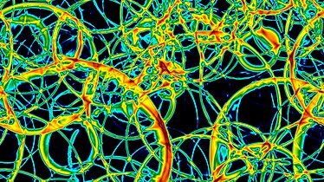
Relevant scenarios
Neutron star mergers
SM matter
Phase transition early Universe
BSM matter
HOlography
Strongly couple Quantum matter + Out of Equilibrium
Notes:
These two aspects are especially relevant in the following scenarios:
NS mergers: NS are made of strongly interacting QM and by measuring the GW we can try to infer properties about the NS EoM, or even the QCD equation of state (1st order phase transition if the chemical potential is not 0?) and SM matter in general.
Phase transitions in the early universe: the transition between QGP and baryons is thought to be a crossover. However, there are still unexplored orders of magnitude in energy in which a phase transition may happen through bubble nucleation (we need bubble to have GW).
Difficulties: we need to study strongly couple QM that is out-of-equilibrium -> Traditional method fails but holography is a good approach to treat this problem.

Slide 5
Why Holography?
Build the QFT properties from first principles
Real time dynamics solving Einstein equations in 4+1 AdS spacetime
Good!
Very difficult to get the 4+1 AdS spacetime from the QFT properties
Bad but…
Notes:
Why holography?
Provides a first principle approach to build the gauge theory and compute observable in a simple way.
To solve the dynamics of the system we just need to solve Eisenstein's equations in a 4+1 AdS space -> We know how to do this using NR techniques.
Once the 4+1 AdS classical gravity theory is fixed, the thermodynamics of the QFT can be trivially computed.
However, if we want a QFT with certain theormodynamical properties, it is not possible to know what to add in the gravity theory. We are going to explore a way of getting it

Slide 6
Outline
Holography in a Nutshell: presenting the model
Physics informed Neural Networks (PINNs)
Results
Conclusions

Slide 7
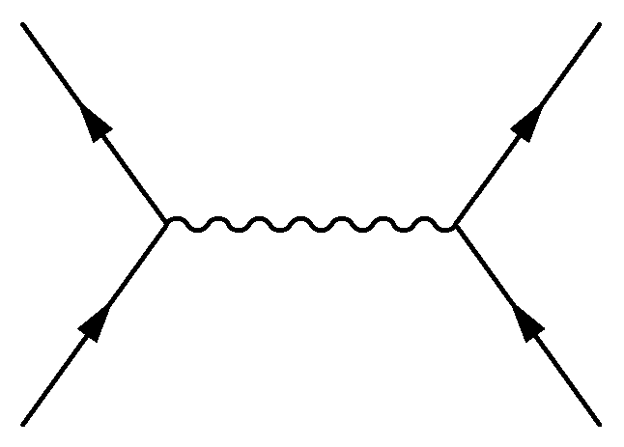
Holography in a Nutshell
QFT in flat spacetime

Slide 8
Holography in a Nutshell
Boundary
AdS in 5D
Bulk

Slide 9
Holography in a Nutshell
Add temperature to the QFT
Add a Black hole
with

Slide 10
Holography in a Nutshell
Phase transitions
Scalar field with
potential

Slide 11
Holography in a Nutshell
Construct different black brane solutions
Solve the EE+KG
Read off the thermodynamics as b.c.

Slide 12
Holography in a Nutshell

Slide 13
Holography in a Nutshell

Slide 14
Holography in a Nutshell

Slide 15
Holography in a Nutshell
Use Neural Networks
??

Slide 16
Physics informed neural networks

Slide 17
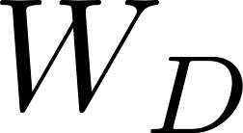
Physics informed neural networks

Slide 18
Physics informed neural networks
[Dissanayake, M and Phan‐Thien, N. 1994]
Use a NN for each unknown function
BC fulfilled by construction
Train for different BC at once
PINNs loss function is defined as the residuals of the differential equations.
[Lagaris et al. 1997]
[Chen et al. 2020]

Slide 19
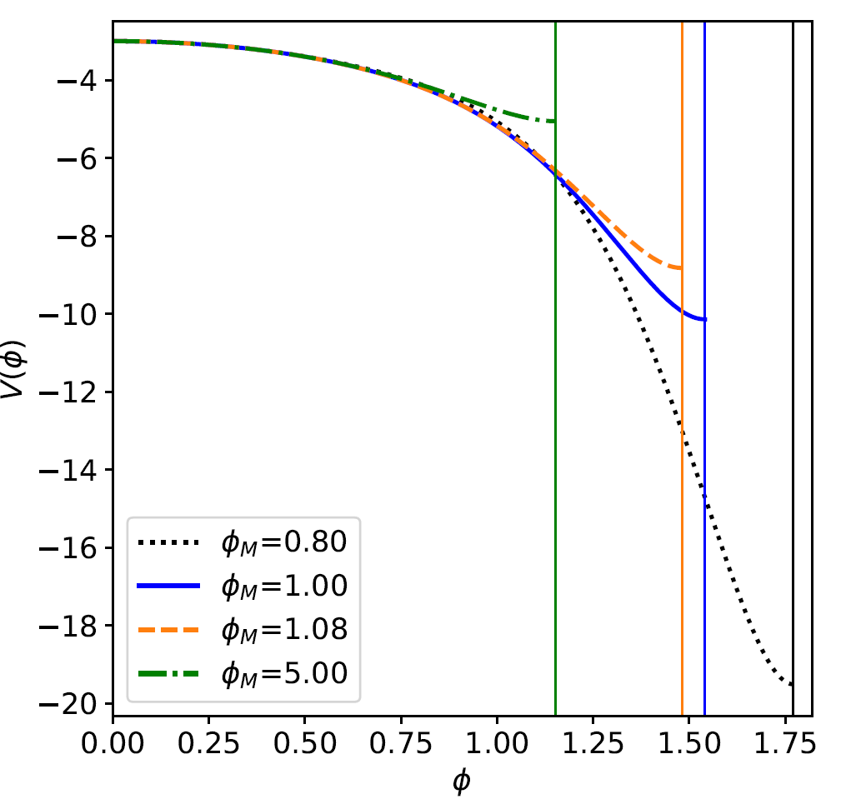
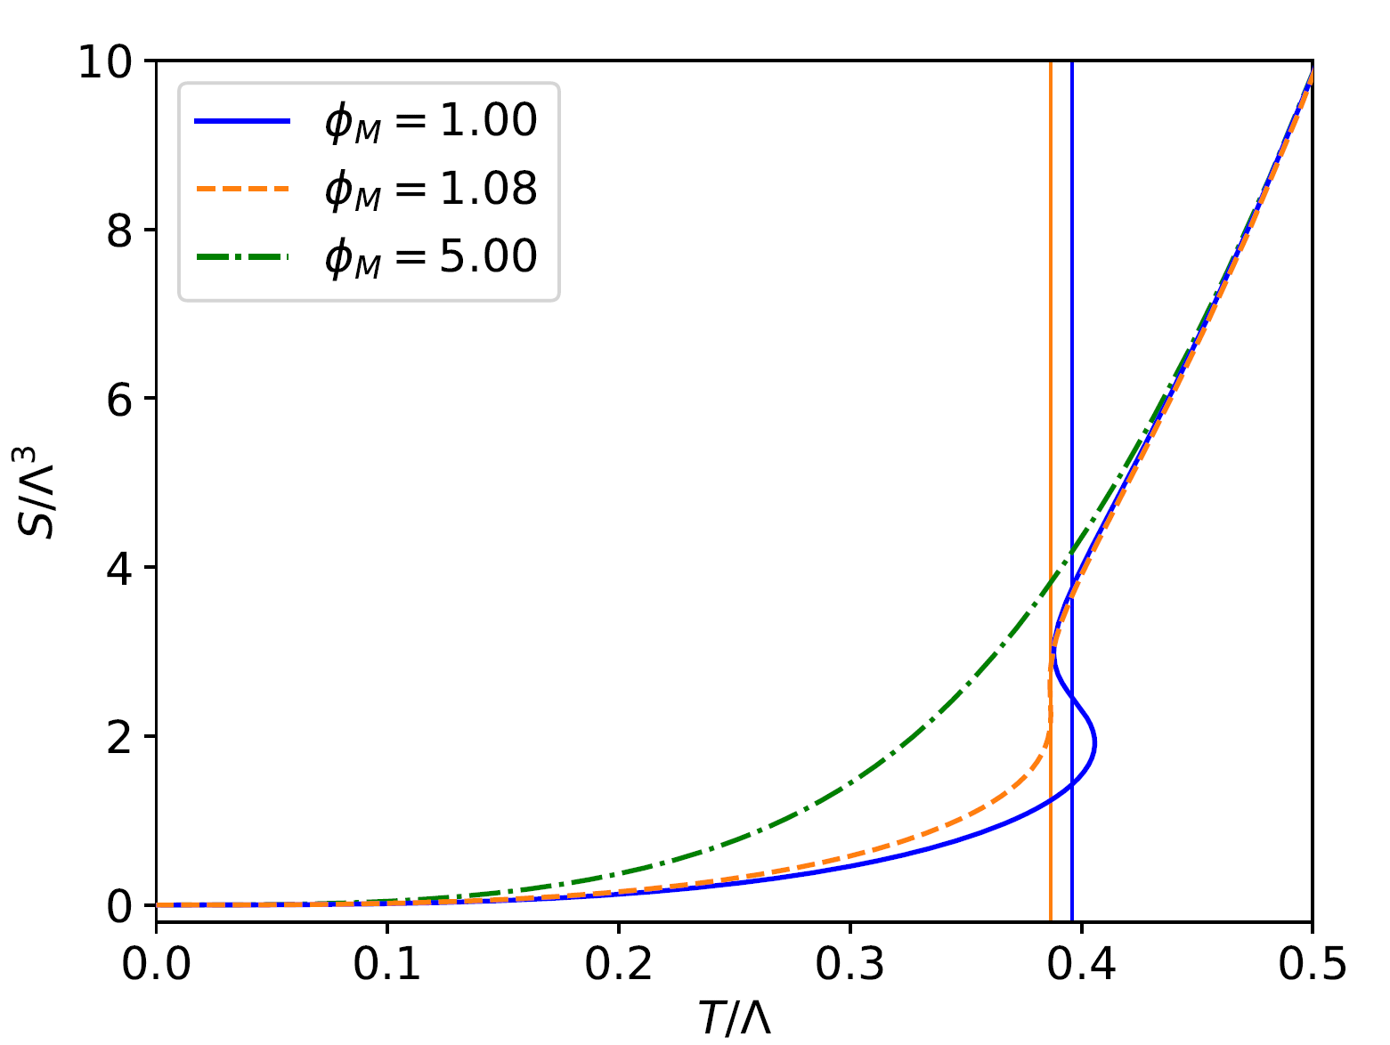
Results
Direct problem

Slide 20
Results
Inverse problem
PINNs

Slide 21
Results
Inverse problem
PINNs
Direct problem
Compare S(T)

Slide 22
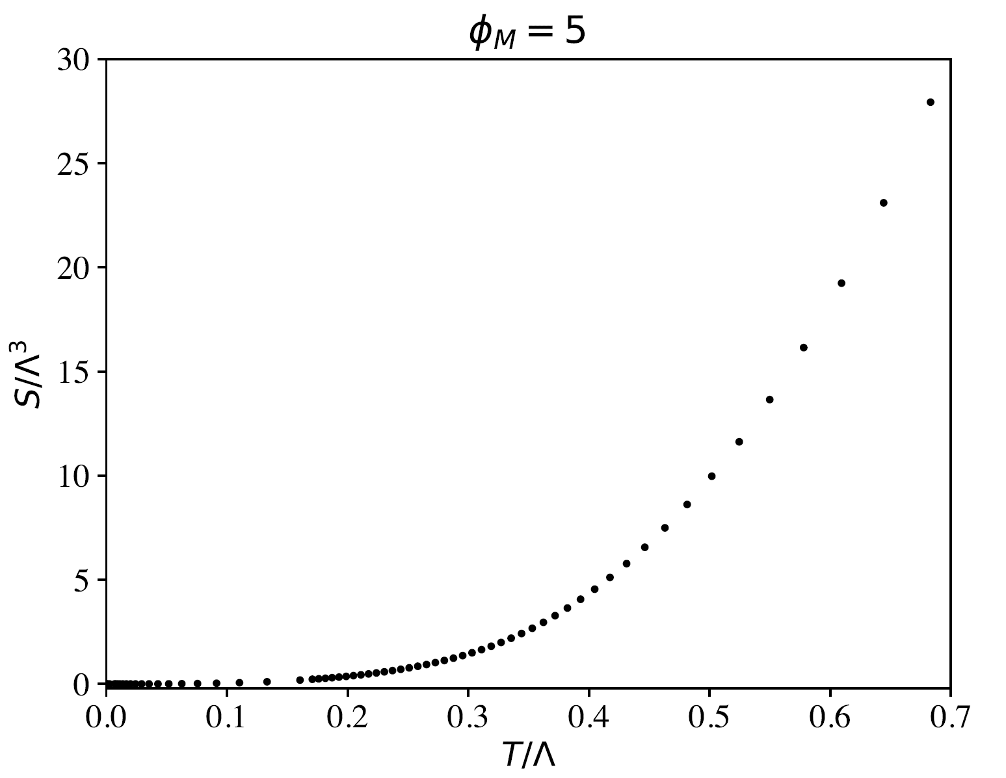
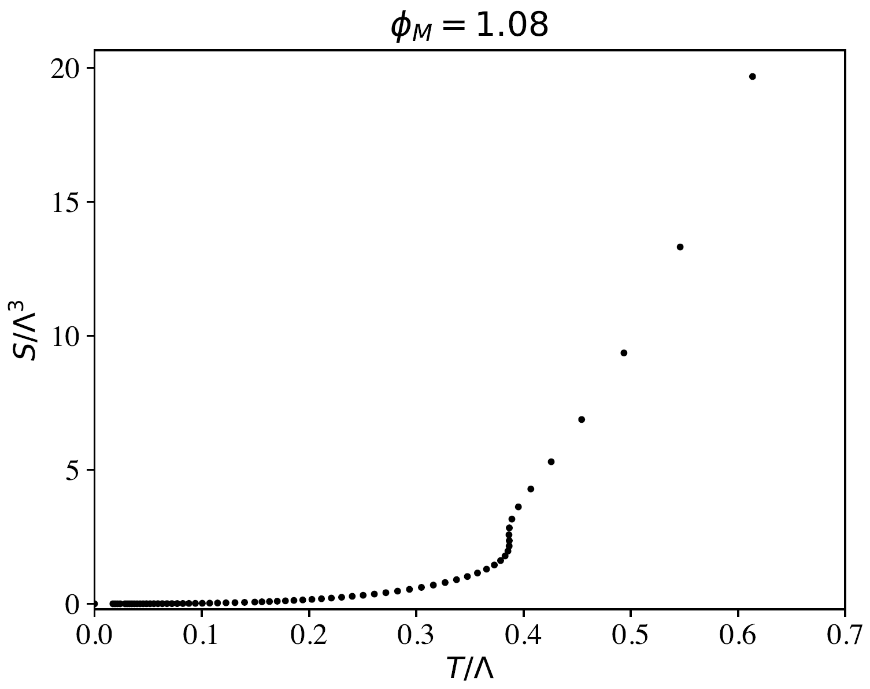
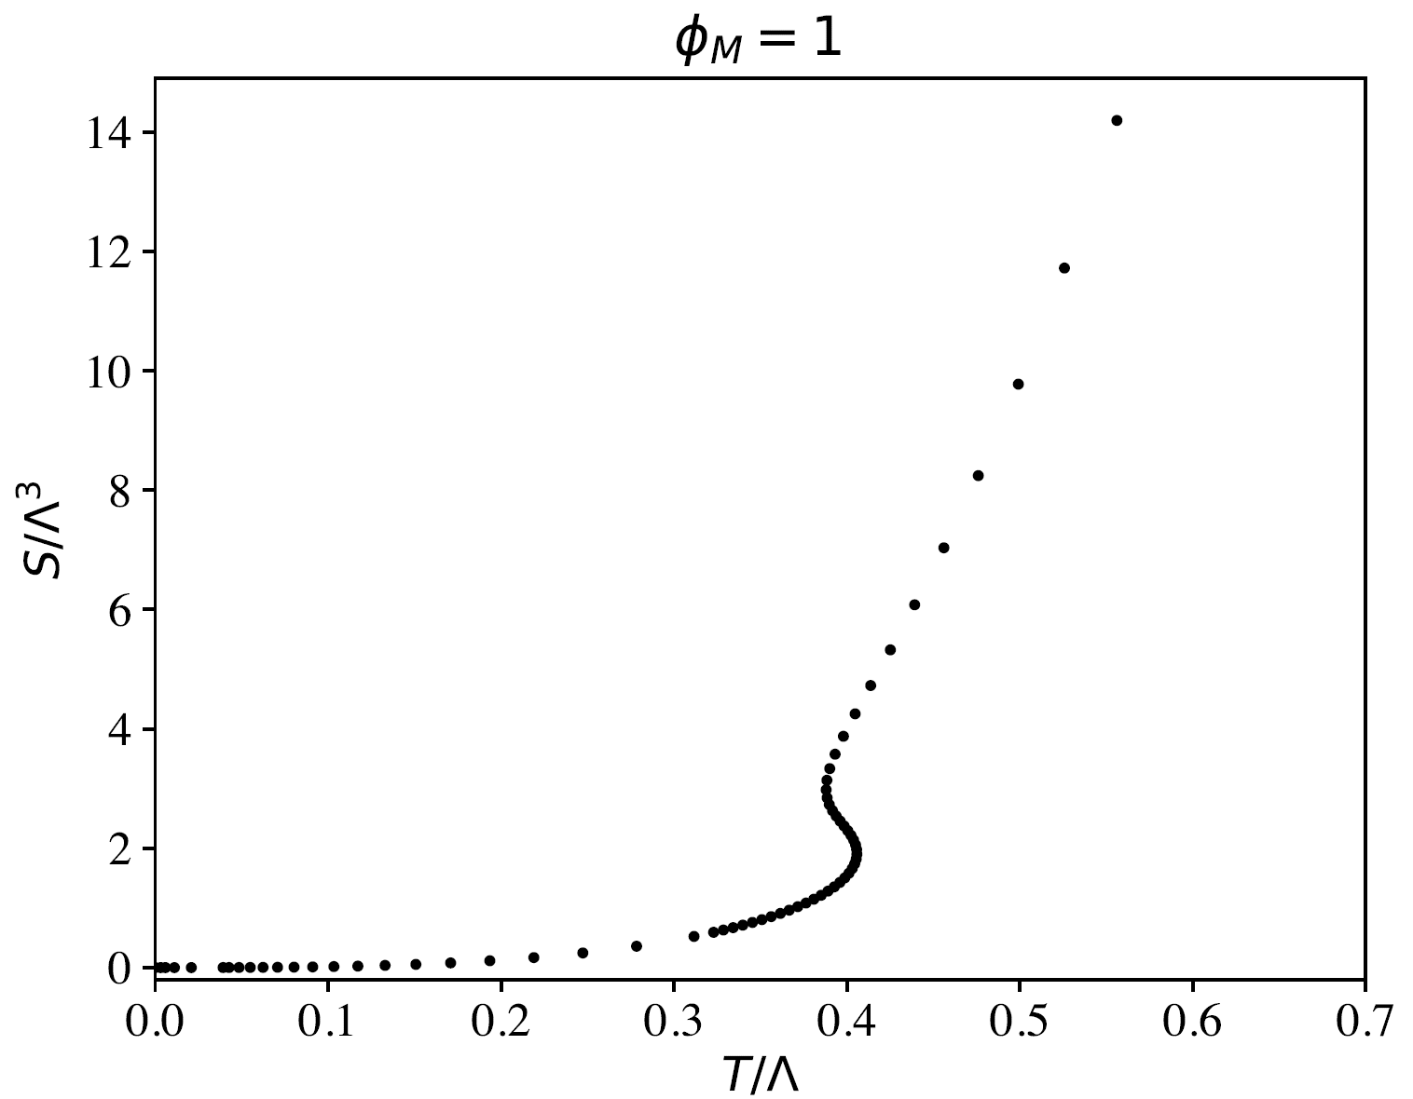
Results
Crossover
Second Order
First Order

Slide 23
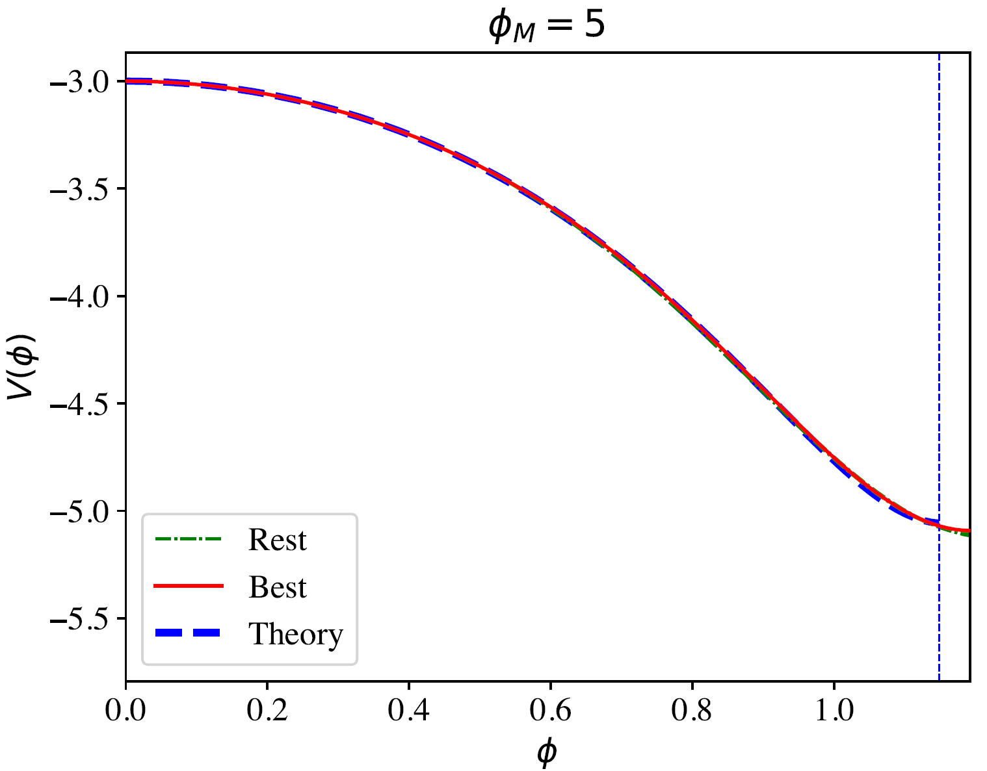
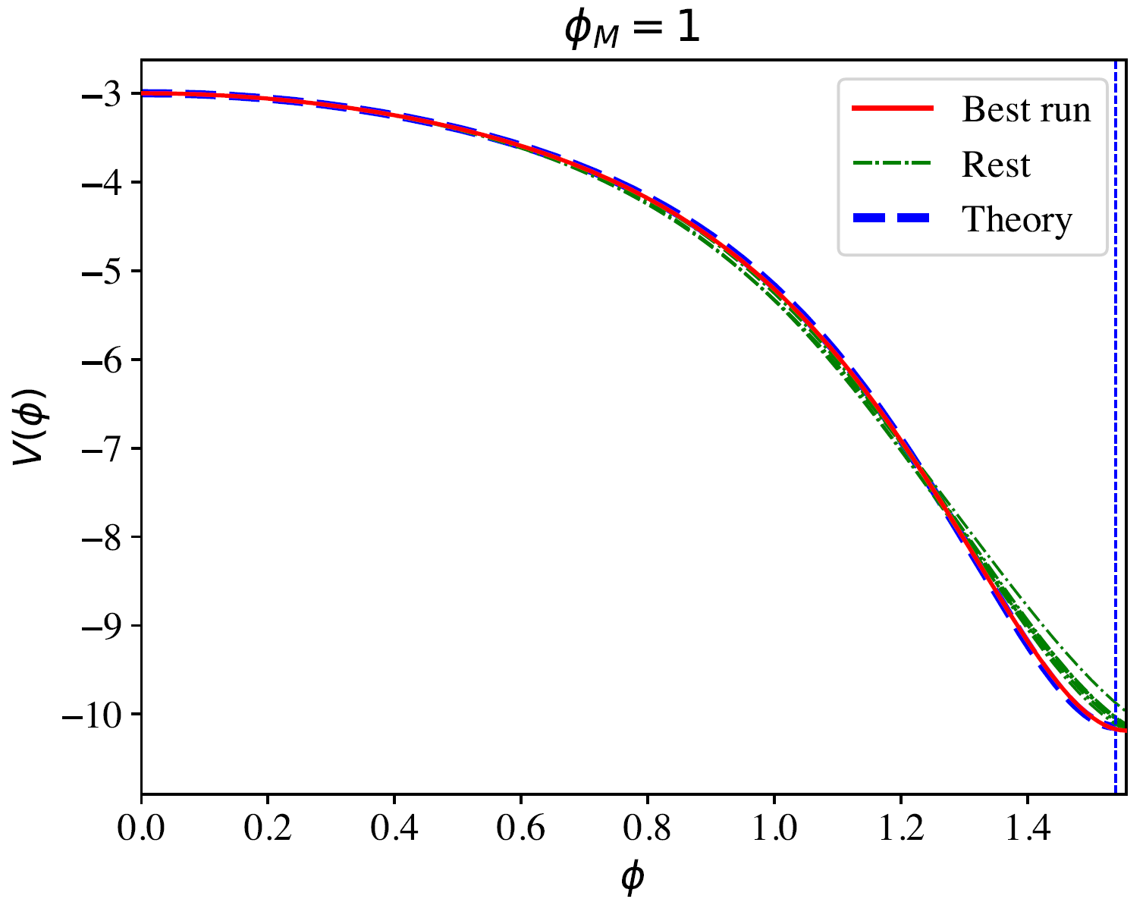
Results
Crossover
Second Order
First Order

Slide 24
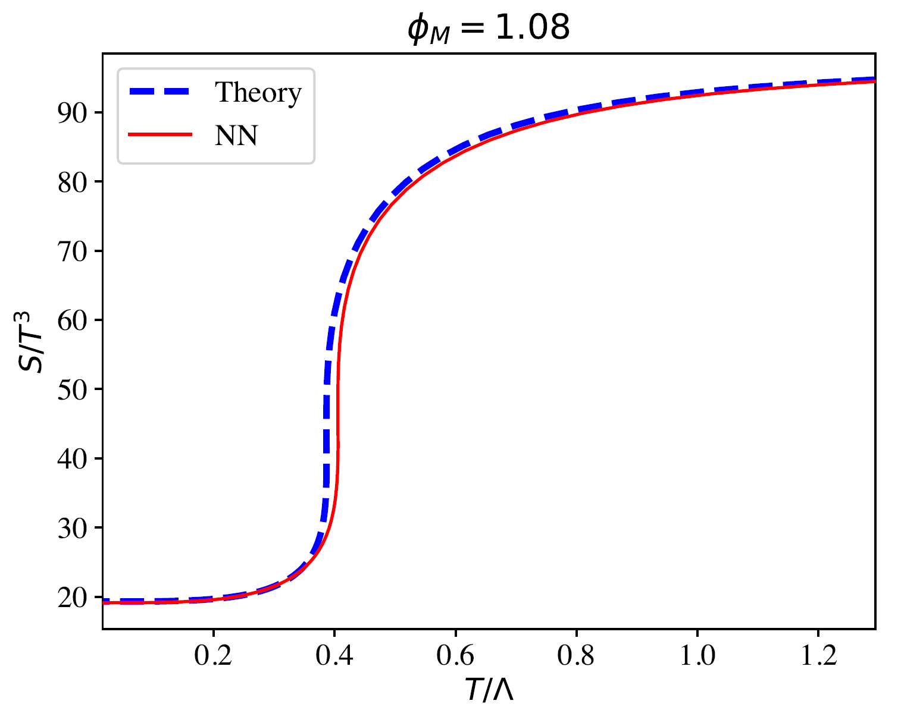
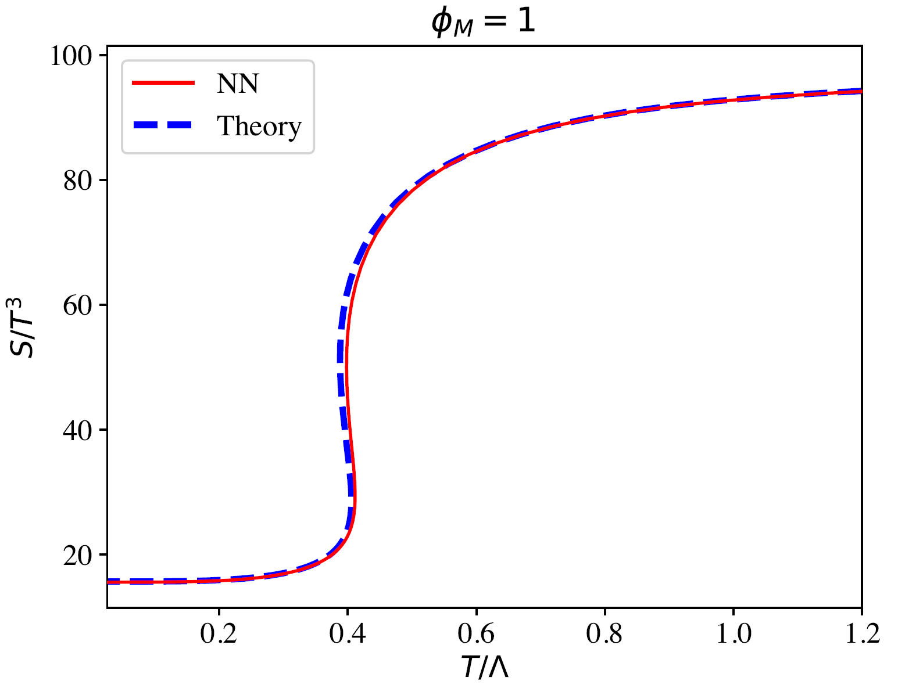
Results
Crossover
Second Order
First Order

Slide 25
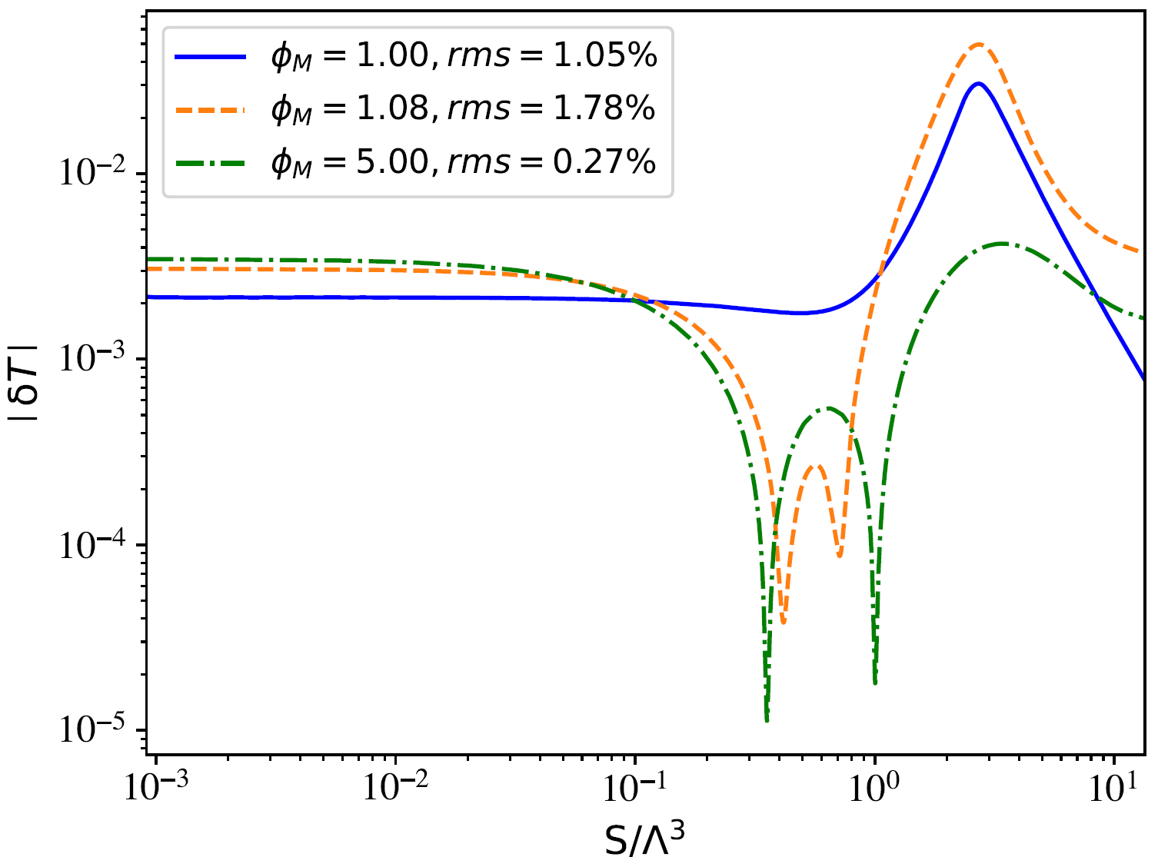
Results
First Order
Second Order
Crossover

Slide 26
Conclusions and future directions
It is possible to recover the bulk gravitational theory using data from the boundary theory. This is a very non-trivial result in the field of Holography.
Generalizable to many situations: several scalar fields, gauge fields, QCD equation of state data…
The setup is not good enough to solve the stiffest cases: false vacuum decay, naked singularity in the bulk…
Method generalizable to other inversion problem involving highly non-linear differential equations, i.e. hydrodynamics.
How are the NNs encoding the RG flow? Could it give us some hints about the scaling of solutions with the energy?
Pau’s talk!
Turbulence

Slide 27
Thank you!

Slide 28
Bibliography
Abbott, B., Abbott, R., Abbott, T., Abernathy, M., Acernese, F., Ackley, K., . . . Zweizig, J. (11 de February de 2016). Observation of Gravitational Waves from a Binary Black Hole Merger. Physical Review Letters, 116. doi:10.1103/physrevlett.116.061102
Chen. (2020). NeuroDiffEq: A Python package for solving differential equations with neural networks. Journal of Open Source Software, 5, 1931. doi:10.21105/joss.01931
Dissanayake, M., & Phan‐thien, N. (March de 1994). Neural‐network‐based approximations for solving partial differential equations. Communications in Numerical Methods in Engineering, 10, 195-201. doi:10.1002/cnm.1640100303
Lagaris, I., Likas, A., & Fotiadis, D. (August de 1997). Artificial neural network methods in quantum mechanics. Computer Physics Communications, 104, 1-14. doi:10.1016/s0010-4655(97)00054-4

Slide 29
Holography equations

Slide 30
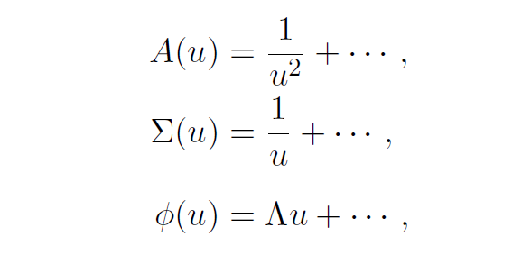
Direct problem details

Slide 31
Potential boundary conditions
Asymp. AdS
UV fixed point in the Gauge theory
Fixes the conf. dimension of the operator

Slide 32
Physics informed neural networks
Activation
Inputs
Output
Weights
Bias

Slide 33
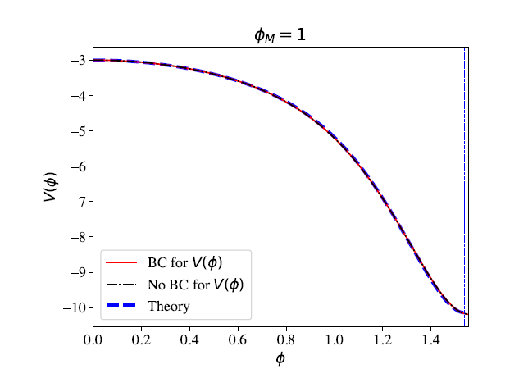
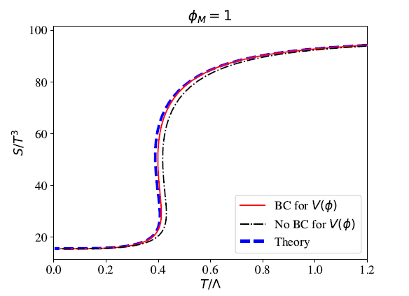
Potential boundary conditions

Slide 34
Physics informed neural networks
Use a NN for each unknown function
B.C are fulfilled exactly by construction
Derivatives are computed analytically
Slow training but evaluation is instantaneous
Perfectly suited for inverse problems
Train for different boundary conditions at once (solution bundle)
Neurodiffeq
[Dissanayake, M and Phan‐Thien, N. 1994]
[Lagaris et al. 1997]
[Chen et al. 2020]

Slide 35
Physics informed neural networks
Equations
Loss function
Boundary conditions

Slide 36
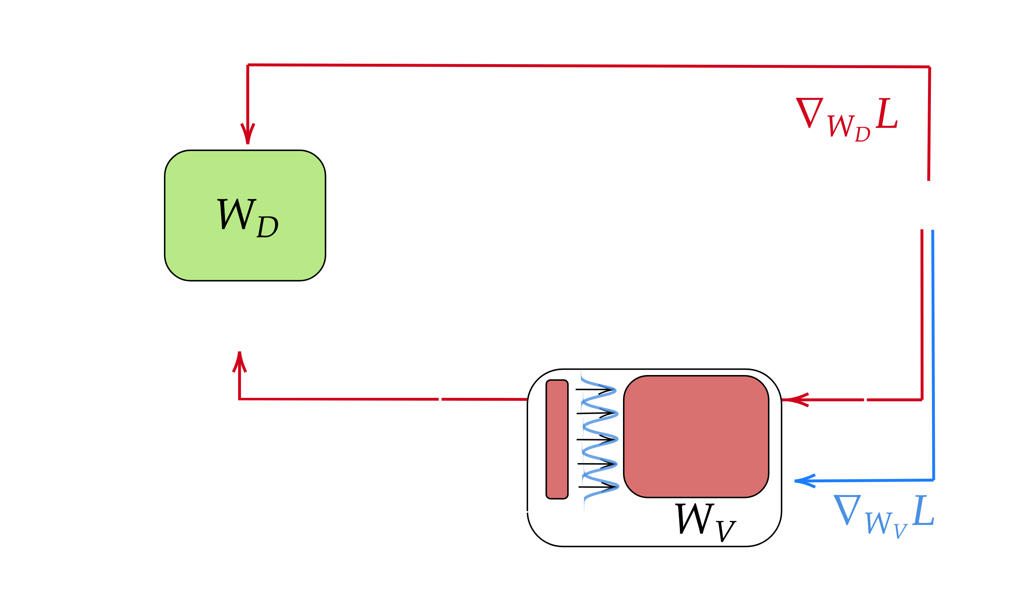
Physics informed neural networks
Gaussian localization

Slide 37
Form of the potential
Family of potentials with a free parameter
Regulates the phase transition in the boundary theory

Slide 38
Physics informed neural networks
Gaussian localization

Slide 39
Physics informed neural networks
Gaussian localization
Fixed sigma’s but learnable mu’s
Each neuron of the first layer will specialize on a certain region of the input domain
Separate loss gradient for inputs that are far apart
Multi-scale → large curvature differences between the boundary and near the horizon region.
Multi-entangled → low-temperature region includes information about the high temperature region

Slide 40
Sampling Techniques for the NN
The independent variable is sampled using Chebyshev nodes of the second kind. We have used 48 points. This allow us to better constrain the function near the boundaries of the interval.
The sampling along the S(T) is chosen to have in between 65-70 points.
This leaves us with a batch size of approx. 3000 points.

Slide 41
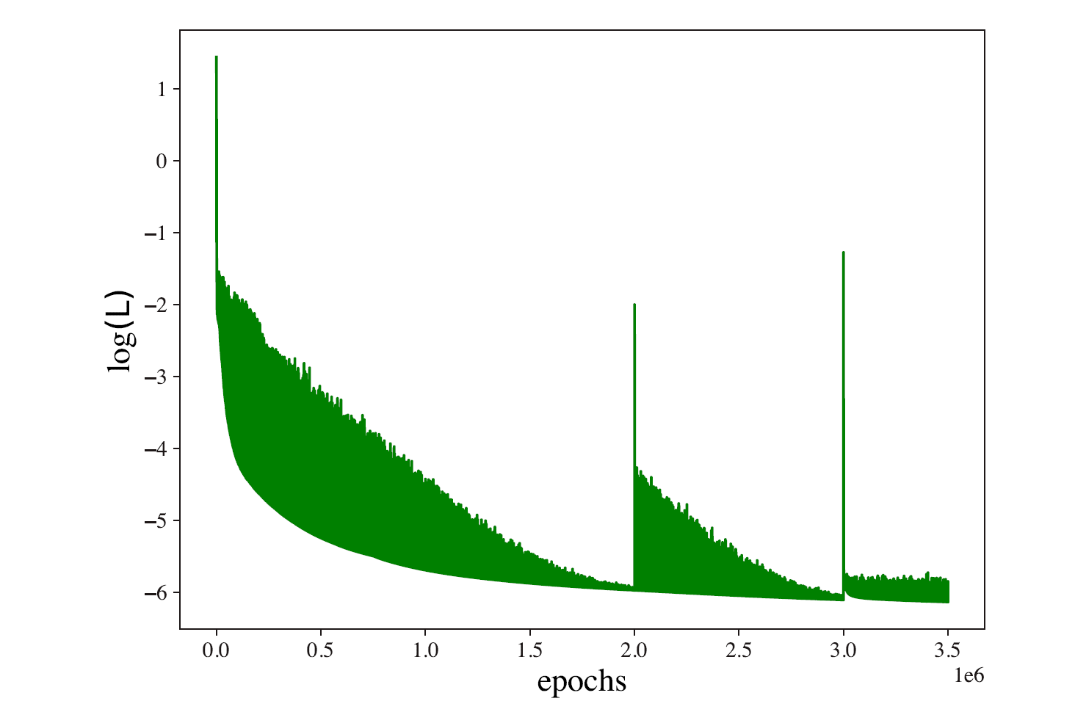
Training details
10 realizations of the same case trained 1e6 epochs.
The case with the lowest loss is trained until the results are good enough.
We add the b.c. of the potential as an additional loss and keep training for some epochs until they are fulfilled.

Slide 42
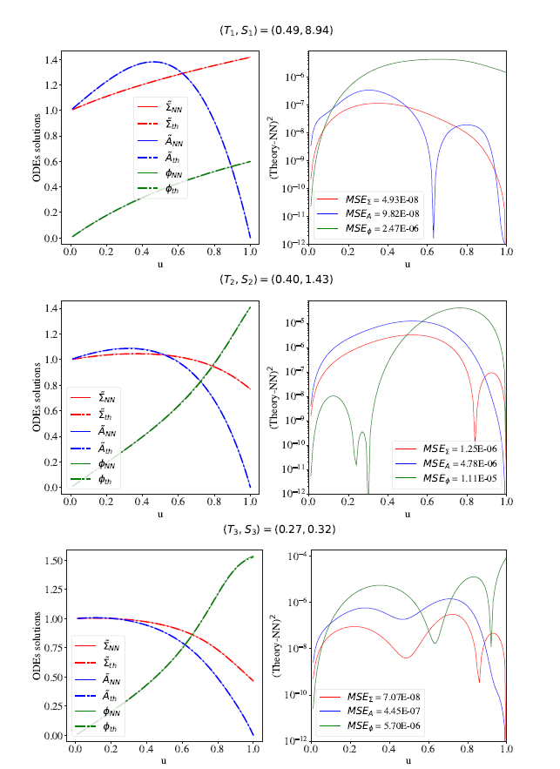
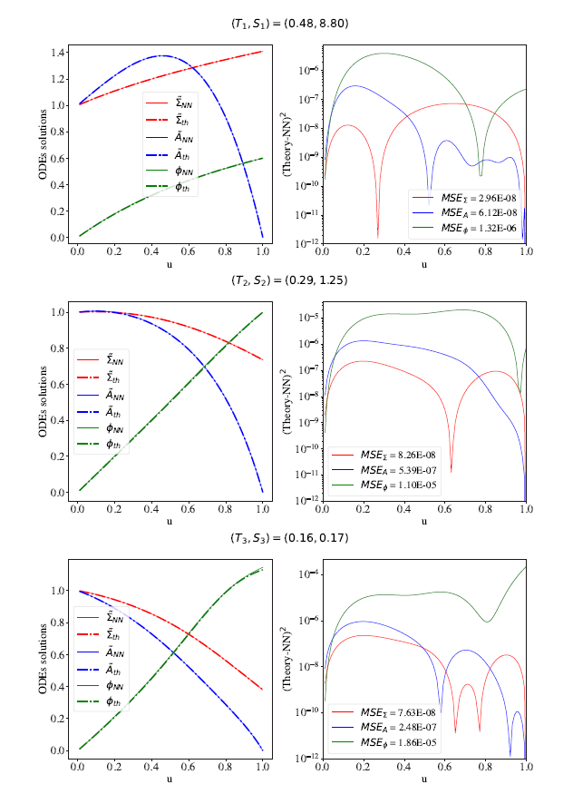
ODE solutions

Slide 43
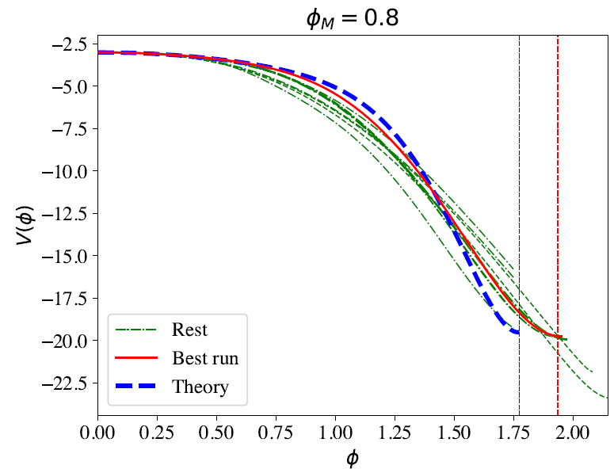
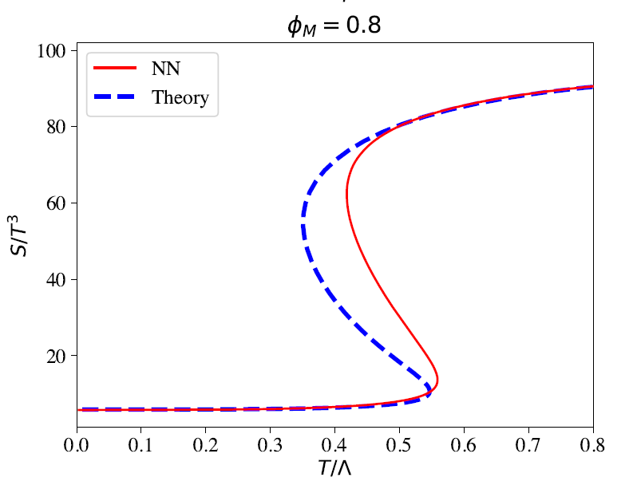
Pathological cases

Slide 44
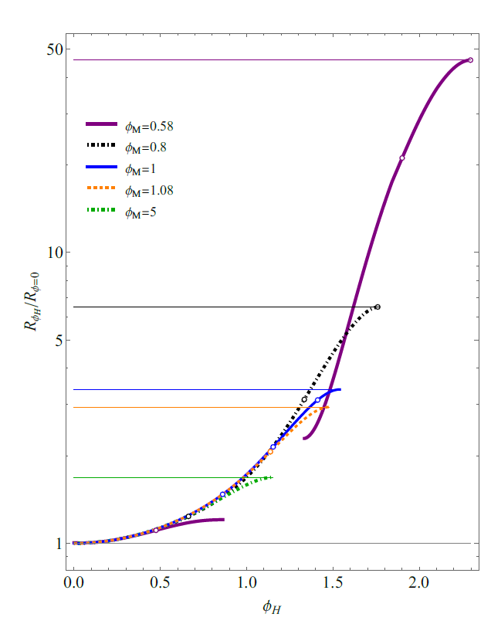
Multi-Scale of the problem

Slide 45
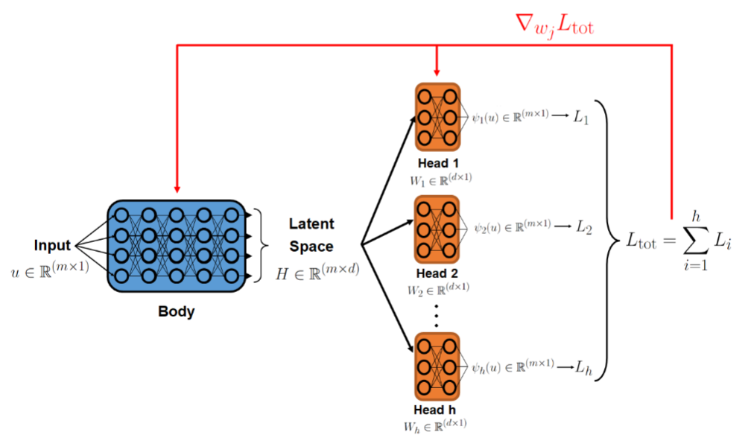
Multihead approach

