Slide 1
New developments in the microstate counting of AdS black holes
Marina David
Based on 2502.10372
with Annelien Vekemans (KU Leuven)
New Insights in Black Hole Physics from Holography
IFT Madrid, 20 June 2025
Notes:
Minimum citations!
Some work in progress
All with student in Leuven

Slide 2
Part 0
Introduction/Motivation

Slide 3
Black hole entropy
horizon
Thermodynamics/macroscopics
Statistical/microscopic origin and interpretation of black hole entropy
Successes through string theory, holography…but is incomplete
$$M,Q,J$$
?
microstates
[Strominger, Vafa 9601029; Benini, Hristov, Zaffaroni 1511.04085…]
Notes:
We know a lot about certain holographic dualities such as AdS5 dual to N=4 SYM and so today and in this work we will focus on a duality that still has yet to be fully understood,
The theory is non-Lagrangian and therefore hard to work with; nevertheless we can still learn some information about the theory from symmetry arguments such as its anomalies, its degrees of freedom scales at N^3
Common strategy for studying such poorly understood theories is to wrap the branes on complex curves and consider the resulting 4d infrared effective theory

Slide 4
The one (duality) less traveled
Why?
Some dualities are well-understood, many are not
Holography is most useful when little is known
Gives us clues/hints – access to information about black holes
Goal: explore less understood holographic duals in 5d/4d
Notes:
Amount of susy is the same on both sides, 4 are normal and 4 are conformal but it is “counted” differently which is why you get N=2 vs N=1
We know a lot about certain holographic dualities such as AdS5 dual to N=4 SYM and so today and in this work we will focus on a duality that still has yet to be fully understood
The worldvolume theory on a stack of M5-branes at low energies is the six-dimensional N=(2,0) superconformal field theory (SCFT) with gauge algebra of the A-type.
The theory is non-Lagrangian and therefore hard to work with; nevertheless we can still learn some information about the theory from symmetry arguments such as its anomalies, its degrees of freedom scales at N^3
Common strategy for studying such poorly understood theories is to wrap the branes on complex curves and consider the resulting 4d infrared effective theory

Slide 5
The one (duality) less traveled
Continue to explore less understood holographic duals in 5d/4d
Our setup: study a 5d/4d EFT from wrapping M5 branes on a Riemann surface
Problems/Opportunities
less tools
limited knowledge from both sides
[Cassani, Komargodski 2104.01464, Gonzalez Lezcano, Hong, Liu, Pando Zayas 2007.12604], [Bah, Beem, Bobev, Wecht 1112.5487, 1203.0303, Benini, Tachikawa, Wecht 0909.1327, Skenderis 0209067, Cassani, Josse, Petrini, Waldram 2011.04775, Maldacena, Nunez, 0007018]
11d supergravity on $AdS_{5}×Σ_{g}×S^{4}$
with $𝓝=2$
Holographic duality
parametrized
by $(N, g, z)$
Class $S$ 4d SCFT
on $S^{1}×S^{3}$ for large $N$ with $𝓝=1$
Notes:
Amount of susy is the same on both sides, 4 are normal and 4 are conformal but it is “counted” differently which is why you get N=2 vs N=1
We know a lot about certain holographic dualities such as AdS5 dual to N=4 SYM and so today and in this work we will focus on a duality that still has yet to be fully understood
The worldvolume theory on a stack of M5-branes at low energies is the six-dimensional N=(2,0) superconformal field theory (SCFT) with gauge algebra of the A-type.
The theory is non-Lagrangian and therefore hard to work with; nevertheless we can still learn some information about the theory from symmetry arguments such as its anomalies, its degrees of freedom scales at N^3
Common strategy for studying such poorly understood theories is to wrap the branes on complex curves and consider the resulting 4d infrared effective theory

Slide 6
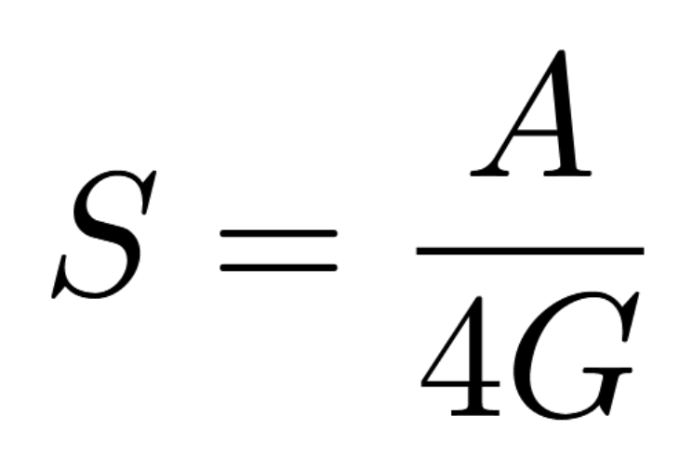
Quick Summary: Microscopic/Macroscopic
Microscopic
4d CFT index gives a prediction to the gravitational free energy
Legendre transform to microcanonical ensemble
Macroscopic
What are the dominating dual gravitational saddles? [Gibbons, Hawking 76’]
Construct novel black hole solutions and compute the Bekenstein-Hawking entropy
Notes:
Evaluate the Gravitational Path Integral via a saddle point approximation; classical solutions of the theory would dominate and Z is just the on-shell action of those saddle points

Slide 7
A small note…
Throughout the talk
Discuss two cases back and forth $(z=±1, z≠±1)$
Summary points in case you lose me ☺

Slide 8
Part 1
The Microscopic Side

Slide 9
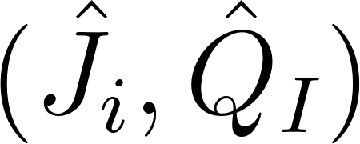
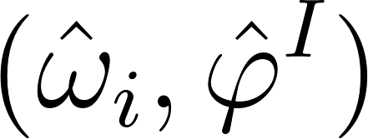
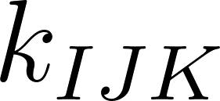
What do we know from CFT?
[Cassani, Komargodski 2104.01464, Gonzalez Lezcano, Hong, Liu, Pando Zayas 2007.12604]
[Cabo-Bizet, Cassani, Martelli, Murthy, 1810.11442, Benini, Milan, 1811.04107, Choi, Kim, Kim, Nahmgoong 1810.12067]
…
The supersymmetric index
Witten index counts difference in the number of bosons and fermions
Gives a prediction to the gravitational free energy
$(I,J)=\left(R,F\right)$ corresponding to $R$ and flavor charges
: charges
: fugacities
: QFT anomalies
Anomalies, charges and potentials are all functions of $z$
Notes:
with SUSY constraint; growth of states of the CFT contains the entropy of the supersymmetric BH
in AdS space.

Slide 10
What do we know from CFT?
[Cassani, Komargodski 2104.01464, Gonzalez Lezcano, Hong, Liu, Pando Zayas 2007.12604]
[Cabo-Bizet, Cassani, Martelli, Murthy, 1810.11442, Benini, Milan, 1811.04107, Choi, Kim, Kim, Nahmgoong 1810.12067]
4d CFT index gives a prediction to the gravitational free energy
$(I,J)=\left(R,F\right)$ corresponding to R and flavor charges
Linear supersymmetric constraint
: thermodynamic charges
: fugacities
: QFT anomalies
Anomalies, charges and potentials are all functions of $z$
integer
Notes:
with SUSY constraint;

Slide 11
The CFT prediction via Legendre transform
[Cabo-Bizet, Cassani, Martelli, Murthy, 1810.11442, Benini, Milan, 1811.04107, Choi, Kim, Kim, Nahmgoong 1810.12067]
Legendre transform to the microcanonical ensemble (i.e. the black hole entropy)
Can be seen as an extremization principle with extremization equations
Plug these back in…
index
SUSY condition
we just need to solve for $Λ$!
Notes:
If you just require, supersymmetry then you will indeed have a complex linear supersymmetry constraint
In most examples and in the case of z=-1 and z=1

Slide 12
The CFT prediction via Legendre transform
Proceed by solving for the entropy
Difficulty
nonlinear equations
no guarantee that these equations can be solved analytically
Resolution
split the analysis for $z=±1$ and $z≠±1$
study the “form” of the index
Notes:
If you just require, supersymmetry then you will indeed have a complex linear supersymmetry constraint
In most examples and in the case of z=-1 and z=1

Slide 13
The CFT prediction via Legendre transform
$$(z=±1)$$
Key observation: form of the index
Leads to a cubic-order identity
Recast as an equation for the Lagrange multiplier
$p_{i}$: functions of charges, anomalies$,g$
Notes:
If you just require, supersymmetry then you will indeed have a complex linear supersymmetry constraint
In most examples and in the case of z=-1 and z=1

Slide 14
The CFT prediction via Legendre transform
$$(z=±1)$$
Goal: solve a cubic-order polynomial
Must have complex conjugate pairs for a real entropy: ${(Λ}_{0},{\overline{Λ}}_{0})$
Consequently, sum over complex conjugate saddles
The result:
Notes:
If you just require, supersymmetry then you will indeed have a complex linear supersymmetry constraint
In most examples and in the case of z=-1 and z=1
Impose additional constraint satisfied by supersymmetric extremal black holes: Im S_0

Slide 15
The CFT prediction via Legendre transform
$$(z≠±1)$$
Still arrive at
But there is a sixth-order identity
Plug these back in…
$q_{i}$: functions of charges, anomalies, $z,g$
Notes:
If you just require, supersymmetry then you will indeed have a complex linear supersymmetry constraint
In most examples and in the case of z=-1 and z=1

Slide 16
The CFT prediction via Legendre transform
$$(z≠±1)$$
**entropy expected to be more nontrivial
Goal: solve a sixth-order polynomial
Again, must have complex conjugate pairs for a real entropy
The result:
Notes:
Impose a constraint that results in supersymmetric extremal black holes

Slide 17
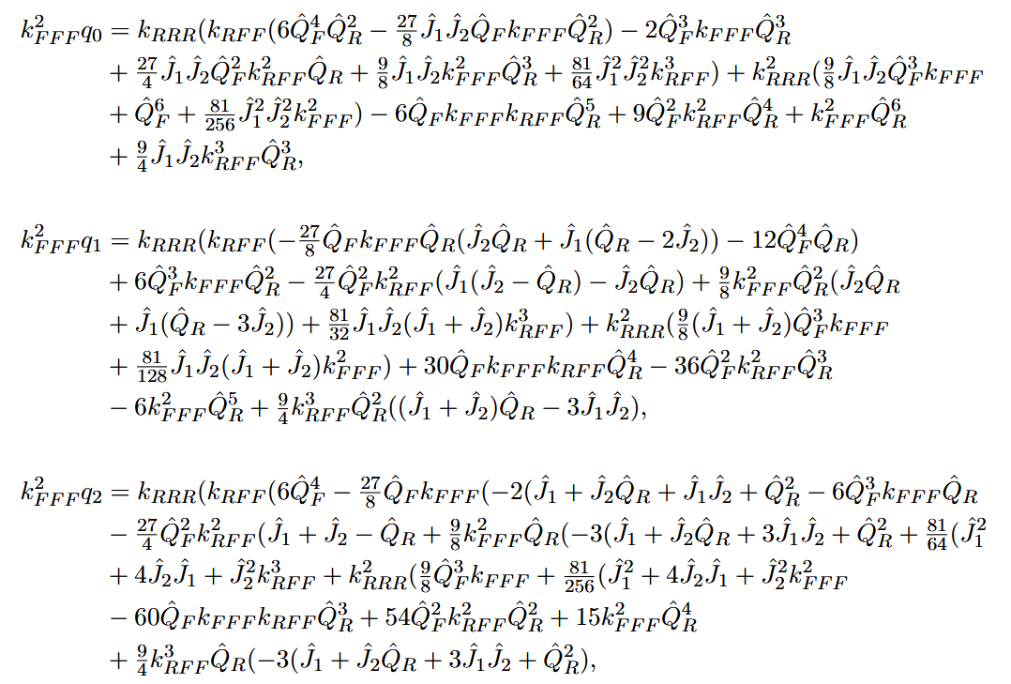
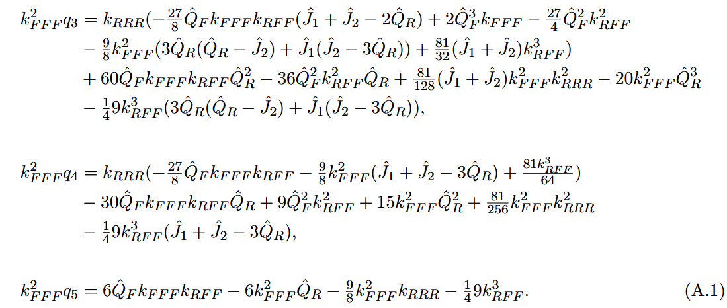
The entropy in its full glory
Entropy
The match will be very nontrivial!
[Bah, Beem, Bobev, Wecht 1112.5487, 1203.0303, Benini, Tachikawa,
Wecht 0909.1327, Skenderis 0209067, Cassani, Josse, Petrini, Waldram 2011.04775]
Notes:
Nonlinear constraint;

Slide 18
Summary
$z=±1$: Legendre transform leads to a cubic equation
$z≠±1$: Legendre transform leads to a sextic equation
Regardless, we found the microscopic prediction for the entropy

Slide 19
Part 2
The Macroscopic Side

Slide 20
The supergravity theory
11d SUGRA maximal 7d $SO(5)$ $U\left(1\right)R× U(1)F$ 5d
5d $𝒩=2$SUGRA contains
Reduction $S^{4}$
consistent truncation
Reduction $Σ_{g}$
gravity multiplet: $\left(gμν, A^{R}\right)$
vector multiplets: $\left(A^{F}, α, Σ\right)$
hypermultiplet: $(φ, ξ, θ1, θ2)$
Notes:
We are left with: (three form, two abelian gauge potentials, 2 scalars) when we reduce to the U(1) times U(1) sector

Slide 21
Overview of black hole solutions
** $J_{1}=J_{2}$
$$(z=±1)$$
$(z≠±1$)
$$Q_{R}≠0$$
$$Q_{F}=0$$
Minimal gauged supergravity
[Bobev, Dimitrov, Vekemans, 2212.10360]
✓
$$Q_{R}≠0$$
$$Q_{F}≠0$$
✗
✗
special limit $→$ our first goal

Slide 22
Part 2.1
The Macroscopic Side: Black hole solutions for $z=±1$

Slide 23
Special limit: $Q_{R}≠0,Q_{F}≠0, z=±1$
Vacua have enhanced supersymmetry: $𝓝=2$ to $𝓝=4$ [Maldacena, Nunez, 0007018]
Hypermultiplet vanishes
nontrivial solution related to the solution of the STU model
Black hole solutions in STU are known [Gutowski, Reall, 0401042, 0401129, Kunduri, Lucietti, Reall, 0601156, Cvetic, Lu, Pope 0407058, Cvetic, Gibbons, Lu, Pope 050480]
Our Theory
5d $𝒩=2$
$U\left(1\right)×U(1)$
with 2 vector + 1 hyper
STU
5d $𝒩=2$
$$U\left(1\right)×U\left(1\right)×U\left(1\right)$$
with 3 vector + 0 hyper
Notes:
Superradiance happens when there are massive but light scalar fields and we don’t have that
Look into Kerr at extremality I the ergosphere (I think everything collapses into the horizon, check if this is true)
Extremality means that the inner and outer horizon coincide or that the temperature of the black hole is small
(no damping); Near-horizon perturbations at critical value: $ω=\frac{m}{2M}$; MD, V. Godet, X. Liu, L. A. Pando Zayas 2112.09444; A. Sen, 0506177; $T \sim \left(r_{+}−r_{−}\right)\sim$ $2\sqrt{1−a^{2}/M^{2}}$; How close is close?
$$λ=\sqrt{1−a^{2}/M^{2}} → \left(\frac{a}{M}=0.99 →λ=0.14\right)$$

Slide 24
Special limit: $Q_{R}≠0,Q_{F}≠0, z=±1$
Hypermultiplet vanishes and other scalars are constrained
Gauge potentials related to the STU model
The metric
Notes:
Superradiance happens when there are massive but light scalar fields and we don’t have that
Look into Kerr at extremality I the ergosphere (I think everything collapses into the horizon, check if this is true)
Extremality means that the inner and outer horizon coincide or that the temperature of the black hole is small
(no damping); Near-horizon perturbations at critical value: $ω=\frac{m}{2M}$; MD, V. Godet, X. Liu, L. A. Pando Zayas 2112.09444; A. Sen, 0506177; $T \sim \left(r_{+}−r_{−}\right)\sim$ $2\sqrt{1−a^{2}/M^{2}}$; How close is close?
$$λ=\sqrt{1−a^{2}/M^{2}} → \left(\frac{a}{M}=0.99 →λ=0.14\right)$$

Slide 25
Black hole thermodynamics and holographic match
$$(z=±1)$$
Step 1: compute all the thermodynamic quantities
Step 2: compute the on-shell action
Step 3: impose supersymmetry
Notes:
Superradiance happens when there are massive but light scalar fields and we don’t have that
Look into Kerr at extremality I the ergosphere (I think everything collapses into the horizon, check if this is true)
Extremality means that the inner and outer horizon coincide or that the temperature of the black hole is small
(no damping); Near-horizon perturbations at critical value: $ω=\frac{m}{2M}$; MD, V. Godet, X. Liu, L. A. Pando Zayas 2112.09444; A. Sen, 0506177; $T \sim \left(r_{+}−r_{−}\right)\sim$ $2\sqrt{1−a^{2}/M^{2}}$; How close is close?
$$λ=\sqrt{1−a^{2}/M^{2}} → \left(\frac{a}{M}=0.99 →λ=0.14\right)$$

Slide 26
Black hole thermodynamics and holographic match
$$(z=±1)$$
Step 4: impose extremality and define supersymmetric fugacities
Step 5: recast the on-shell action
Step 6: write the entropy in terms of the charges
Precise match!
Notes:
Superradiance happens when there are massive but light scalar fields and we don’t have that
Look into Kerr at extremality I the ergosphere (I think everything collapses into the horizon, check if this is true)
Extremality means that the inner and outer horizon coincide or that the temperature of the black hole is small
(no damping); Near-horizon perturbations at critical value: $ω=\frac{m}{2M}$; MD, V. Godet, X. Liu, L. A. Pando Zayas 2112.09444; A. Sen, 0506177; $T \sim \left(r_{+}−r_{−}\right)\sim$ $2\sqrt{1−a^{2}/M^{2}}$; How close is close?
$$λ=\sqrt{1−a^{2}/M^{2}} → \left(\frac{a}{M}=0.99 →λ=0.14\right)$$

Slide 27
Summary
We identified the black hole solution for $z=±1$
and its entropy matches the CFT prediction!

Slide 28
Part 2.2
The Macroscopic Side: Black hole solutions for $z≠±1$

Slide 29
Overview of black hole solutions
** $J_{1}=J_{2}$
$$(z=±1)$$
$(z≠±1$)
$$Q_{R}≠0$$
$$Q_{F}=0$$
Minimal gauged supergravity
[Bobev, Dimitrov, Vekemans, 2212.10360]
✓
$$Q_{R}≠0$$
$$Q_{F}≠0$$
✓
✗
our ultimate goal
How do we find the solution?

Slide 30
How do we find black hole solutions?
An “obvious” ansatz using known solutions
Solve the killing spinor equations
5d equivariant localization [Cassani, Ruipérez, Turetta, 2409.01332, Colombo, Dimitrov, Martelli, Zaffaroni 2502.15624]
Numerical techniques
Perturbative expansion around known solutions
Focus on the near-horizon regime
We take a 2-step approach
Notes:
Superradiance happens when there are massive but light scalar fields and we don’t have that
Look into Kerr at extremality I the ergosphere (I think everything collapses into the horizon, check if this is true)
Extremality means that the inner and outer horizon coincide or that the temperature of the black hole is small
(no damping); Near-horizon perturbations at critical value: $ω=\frac{m}{2M}$; MD, V. Godet, X. Liu, L. A. Pando Zayas 2112.09444; A. Sen, 0506177; $T \sim \left(r_{+}−r_{−}\right)\sim$ $2\sqrt{1−a^{2}/M^{2}}$; How close is close?
$$λ=\sqrt{1−a^{2}/M^{2}} → \left(\frac{a}{M}=0.99 →λ=0.14\right)$$

Slide 31
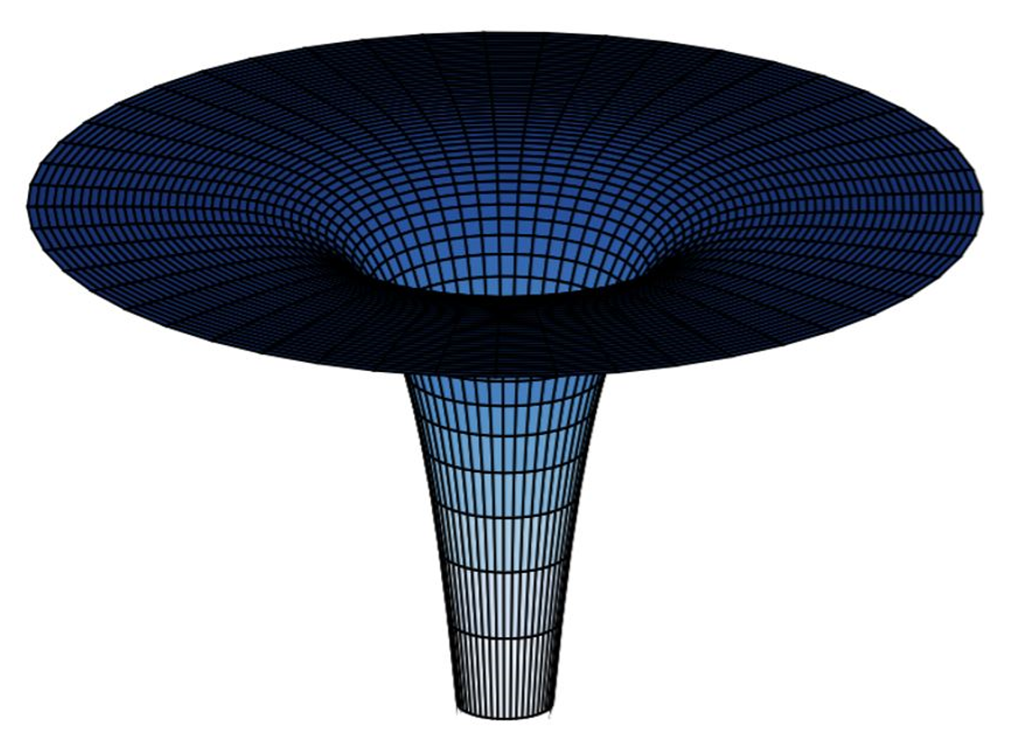
Near horizon extremal geometries (NHEG)
$$(z≠±1)$$
Step 1: General solution $z≠1$ is out of reach except for the NHEG
Small temperature regime and/or NHEG
many recent applications!
Enhancement of symmetries: $SO(2,1)$ at the horizon
NHEG is sufficient to verify the CFT prediction and show such a solution exists
asymptotic
$${AdS}_{2}$$
region
Notes:
Superradiance happens when there are massive but light scalar fields and we don’t have that
Look into Kerr at extremality I the ergosphere (I think everything collapses into the horizon, check if this is true)
Extremality means that the inner and outer horizon coincide or that the temperature of the black hole is small
(no damping); Near-horizon perturbations at critical value: $ω=\frac{m}{2M}$; MD, V. Godet, X. Liu, L. A. Pando Zayas 2112.09444; A. Sen, 0506177; $T \sim \left(r_{+}−r_{−}\right)\sim$ $2\sqrt{1−a^{2}/M^{2}}$; How close is close?
$$λ=\sqrt{1−a^{2}/M^{2}} → \left(\frac{a}{M}=0.99 →λ=0.14\right)$$

Slide 32
Near horizon extremal ansatz
$$(z≠±1)$$
left invariant 1-forms
metric ansatz
Potential and scalars ansatz
Equations of motion are now all algebraic!
$${AdS}_{2}$$
Notes:
Superradiance happens when there are massive but light scalar fields and we don’t have that
Look into Kerr at extremality I the ergosphere (I think everything collapses into the horizon, check if this is true)
Extremality means that the inner and outer horizon coincide or that the temperature of the black hole is small
(no damping); Near-horizon perturbations at critical value: $ω=\frac{m}{2M}$; MD, V. Godet, X. Liu, L. A. Pando Zayas 2112.09444; A. Sen, 0506177; $T \sim \left(r_{+}−r_{−}\right)\sim$ $2\sqrt{1−a^{2}/M^{2}}$; How close is close?
$$λ=\sqrt{1−a^{2}/M^{2}} → \left(\frac{a}{M}=0.99 →λ=0.14\right)$$

Slide 33
Near horizon extremal ansatz
$$(z≠±1)$$
Step 2: Additional simplification $z=1+ε$
Our “seed” solution is the NHEG of the $z=1$ solution
Equations of motion are now all algebraic and linear
9 equations of motion & 11 unknown constants
Solution is supersymmetric + extremal → 2 independent parameters
Notes:
9 equations of motion & 11 unknown constants – 2 free integration constants

Slide 34
The seed solution
The metric functions
The potential
The scalars
Notes:
Superradiance happens when there are massive but light scalar fields and we don’t have that
Look into Kerr at extremality I the ergosphere (I think everything collapses into the horizon, check if this is true)
Extremality means that the inner and outer horizon coincide or that the temperature of the black hole is small
(no damping); Near-horizon perturbations at critical value: $ω=\frac{m}{2M}$; MD, V. Godet, X. Liu, L. A. Pando Zayas 2112.09444; A. Sen, 0506177; $T \sim \left(r_{+}−r_{−}\right)\sim$ $2\sqrt{1−a^{2}/M^{2}}$; How close is close?
$$λ=\sqrt{1−a^{2}/M^{2}} → \left(\frac{a}{M}=0.99 →λ=0.14\right)$$

Slide 35
Near horizon extremal solution
$$(z≠±1)$$
Only the scalars and (flavor) gauge potential are corrected!
Expansion can be done past the leading order – future work
**first partial solution with hypers in this theory
scalars
potential
Notes:
Superradiance happens when there are massive but light scalar fields and we don’t have that
Look into Kerr at extremality I the ergosphere (I think everything collapses into the horizon, check if this is true)
Extremality means that the inner and outer horizon coincide or that the temperature of the black hole is small
(no damping); Near-horizon perturbations at critical value: $ω=\frac{m}{2M}$; MD, V. Godet, X. Liu, L. A. Pando Zayas 2112.09444; A. Sen, 0506177; $T \sim \left(r_{+}−r_{−}\right)\sim$ $2\sqrt{1−a^{2}/M^{2}}$; How close is close?
$$λ=\sqrt{1−a^{2}/M^{2}} → \left(\frac{a}{M}=0.99 →λ=0.14\right)$$

Slide 36
Summary
We constructed the NHEG of the
black hole solution for $z≠±1$

Slide 37
What about the on-shell action?
Bad news:
No access to the on-shell action from the horizon
Need asymptotic data (mass, etc)
Good news:
Entropy can be determined
Check with the microscopic prediction
Notes:
Superradiance happens when there are massive but light scalar fields and we don’t have that
Look into Kerr at extremality I the ergosphere (I think everything collapses into the horizon, check if this is true)
Extremality means that the inner and outer horizon coincide or that the temperature of the black hole is small
(no damping); Near-horizon perturbations at critical value: $ω=\frac{m}{2M}$; MD, V. Godet, X. Liu, L. A. Pando Zayas 2112.09444; A. Sen, 0506177; $T \sim \left(r_{+}−r_{−}\right)\sim$ $2\sqrt{1−a^{2}/M^{2}}$; How close is close?
$$λ=\sqrt{1−a^{2}/M^{2}} → \left(\frac{a}{M}=0.99 →λ=0.14\right)$$

Slide 38
Near-horizon thermodynamics
Have access to some thermodynamic quantities from the NHEG: $(S, Q, J, ω, φ)$
$(S)$: Entropy
($Q, J):$ charges must satisfy a Gauss law
$(ω, φ)$: fugacities
Notes:
Superradiance happens when there are massive but light scalar fields and we don’t have that
Look into Kerr at extremality I the ergosphere (I think everything collapses into the horizon, check if this is true)
Extremality means that the inner and outer horizon coincide or that the temperature of the black hole is small
(no damping); Near-horizon perturbations at critical value: $ω=\frac{m}{2M}$; MD, V. Godet, X. Liu, L. A. Pando Zayas 2112.09444; A. Sen, 0506177; $T \sim \left(r_{+}−r_{−}\right)\sim$ $2\sqrt{1−a^{2}/M^{2}}$; How close is close?
$$λ=\sqrt{1−a^{2}/M^{2}} → \left(\frac{a}{M}=0.99 →λ=0.14\right)$$

Slide 39
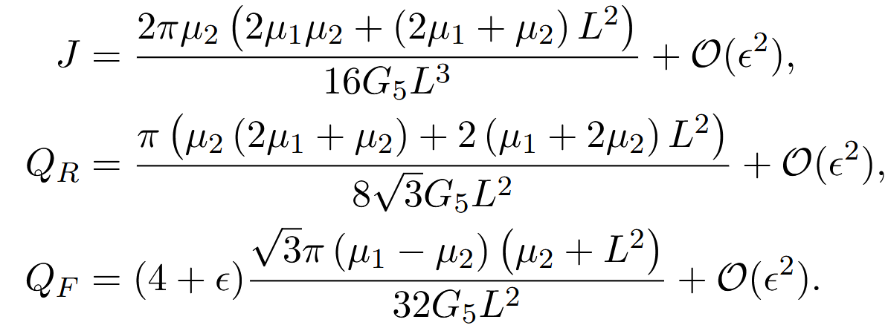
Near-horizon thermodynamics
Have access to some thermodynamic quantities from the NHEG: $(S, Q, J, ω, φ)$
$(S)$: Entropy
($Q, J):$ charges must satisfy a Gauss law
$(ω, φ)$: fugacities
Notes:
Superradiance happens when there are massive but light scalar fields and we don’t have that
Look into Kerr at extremality I the ergosphere (I think everything collapses into the horizon, check if this is true)
Extremality means that the inner and outer horizon coincide or that the temperature of the black hole is small
(no damping); Near-horizon perturbations at critical value: $ω=\frac{m}{2M}$; MD, V. Godet, X. Liu, L. A. Pando Zayas 2112.09444; A. Sen, 0506177; $T \sim \left(r_{+}−r_{−}\right)\sim$ $2\sqrt{1−a^{2}/M^{2}}$; How close is close?
$$λ=\sqrt{1−a^{2}/M^{2}} → \left(\frac{a}{M}=0.99 →λ=0.14\right)$$

Slide 40
Near-horizon thermodynamics
Have access to some thermodynamic quantities from the NHEG: $(S, Q, J, ω, φ)$
$(S)$: Entropy
($Q, J ):$ charges must satisfy a Gauss law
$(ω, φ)$: fugacities
Near-horizon version of the first law
Notes:
Superradiance happens when there are massive but light scalar fields and we don’t have that
Look into Kerr at extremality I the ergosphere (I think everything collapses into the horizon, check if this is true)
Extremality means that the inner and outer horizon coincide or that the temperature of the black hole is small
(no damping); Near-horizon perturbations at critical value: $ω=\frac{m}{2M}$; MD, V. Godet, X. Liu, L. A. Pando Zayas 2112.09444; A. Sen, 0506177; $T \sim \left(r_{+}−r_{−}\right)\sim$ $2\sqrt{1−a^{2}/M^{2}}$; How close is close?
$$λ=\sqrt{1−a^{2}/M^{2}} → \left(\frac{a}{M}=0.99 →λ=0.14\right)$$

Slide 41
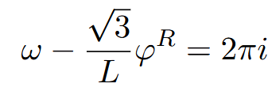
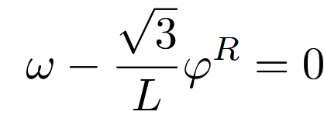
A comment - supersymmetry
Order of supersymmetry and extremal limits do not commute!
Supersymmetry then extremal leads to a complex BPS relation
NHEG leads to a real BPS relation
Notes:
Superradiance happens when there are massive but light scalar fields and we don’t have that
Look into Kerr at extremality I the ergosphere (I think everything collapses into the horizon, check if this is true)
Extremality means that the inner and outer horizon coincide or that the temperature of the black hole is small
(no damping); Near-horizon perturbations at critical value: $ω=\frac{m}{2M}$; MD, V. Godet, X. Liu, L. A. Pando Zayas 2112.09444; A. Sen, 0506177; $T \sim \left(r_{+}−r_{−}\right)\sim$ $2\sqrt{1−a^{2}/M^{2}}$; How close is close?
$$λ=\sqrt{1−a^{2}/M^{2}} → \left(\frac{a}{M}=0.99 →λ=0.14\right)$$

Slide 42
The black hole entropy
$$(z≠±1)$$
Macroscopic (5d black hole)
Cannot compute the on-shell action from the NHEG
Entropy from the area formula
Rewrite entropy in terms of the charges
Microscopic (4d CFT index)
Legendre transform to microcanonical ensemble: entropy in terms of
Entropy for the most general black hole was found --- expand in $z$
In both cases:

Slide 43
Overview of black hole solutions
** $J_{1}=J_{2}$
$$(z=±1)$$
$(z≠±1$)
$$Q_{R}≠0$$
$$Q_{F}=0$$
Minimal gauged supergravity
[Bobev, Dimitrov, Vekemans, 2212.10360]
✓
$$Q_{R}≠0$$
$$Q_{F}≠0$$
what we accomplished!
✓
~✓

Slide 44
Conclusion
Overview
Identified a new class of black hole solutions
First instance of a solution with hyperscalars
Match to CFT prediction hints that a black hole with this NHEG exists
Future Directions
Find the global solution for all values of $z$
Match linear ‘t Hooft anomalies corresponding to higher derivative corrections
Deeper understanding of the Legendre transform
Thank you for your attention!
Notes:
Unequal angular momenta, all rational values of $z$, NHEK or full

Slide 45
Key features of the theory
STU model
the structure constants satisfy a closure relation
This relation ensures the existence of a “cubic-order” identity
Hypermultiplets → the scalar manifold is no longer symmetric and the closure relation does not hold.
Is the existence of such a relation connected to properties of the QFT?
Notes:
The scalar fields belonging to the vector multiplet in this model parameterize a symmetric space and the closure relation

Slide 46
Summary: the solutions
$$Q_{R}≠Q_{F}, J, z=±1$$
Full solution
hypermultiplet vanishes
a modification of STU
vacua has enhanced SUSY (MN $𝒩=4$)
$$Q_{R}≠Q_{F}, J, z=1+ε$$
Near-horizon extremal geometry
First solution with hyperscalars
** sufficient to verify CFT prediction for all nontrivial values of $z$ (outside $z=±1)$
**except for a spin expansion
Notes:
**perturb around modified Kerr
***spin expansion
Now we repeat the process with HD, this is hard for the following reasons, Write all the metric components with these tetrads, Kerr (Universal Teukolsky equations for HD – perturbatively close to Kerr
Note in GR, you can also go to the horizon to try to probe these near-extremal QNM, this was work done back in 2015

Slide 47
Misc backup slides

Slide 48
The holographic match
Cannot compute the on-shell action from the NHEG $→$ entropy from the area formula
Entropy receives no corrections when written via
Recast via the charges of the solution
Precise match after utilizing holographic dictionary and expanding

Slide 49
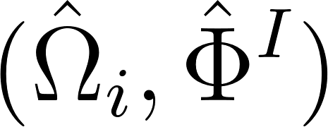
What do we know from CFT?
4d CFT index gives a prediction to the gravitational free energy
Legendre transform to microcanonical ensemble
Missing piece of the puzzle: what are the dominating dual gravitational saddles?
Search for hints: do black holes dual to this 4d CFT and this counting of states exist?
: chemical potentials
: thermodynamic charges
: fugacities
: QFT anomalies
[Cassani, Komargodski 2104.01464, Gonzalez Lezcano, Hong, Liu, Pando Zayas 2007.12604]
Notes:
with SUSY constraint;

Slide 50
The CFT prediction via Legendre transform
Cabo-Bizet, Cassani, Martelli, Murthy, 1810.11442, Benini, Milan, 1811.04107, Choi, Kim, Kim, Nahmgoong 1810.12067
Extremize the entropy function
In most examples
Hypermultiplets changes this…
index
susy condition
$p_{i},q_{i}$: functions of charges, anomalies, $z,g$
**entropy expected to be more nontrivial
Notes:
If you just require, supersymmetry then you will indeed have a complex linear supersymmetry constraint
In most examples and in the case of z=-1 and z=1

Slide 51
The CFT prediction via Legendre transform
Cabo-Bizet, Cassani, Martelli, Murthy, 1810.11442, Benini, Milan, 1811.04107, Choi, Kim, Kim, Nahmgoong 1810.12067
Extremize the entropy function
In most examples
Hypermultiplets changes this…
index
susy condition
$p_{i},q_{i}$: functions of charges, anomalies, $z,g$
**entropy expected to be more nontrivial
Notes:
If you just require, supersymmetry then you will indeed have a complex linear supersymmetry constraint
In most examples and in the case of z=-1 and z=1

Slide 52
Overview of gravity solutions
“holy grail”
black hole solutions
$$Q_{R}≠0,Q_{F}≠0,J_{1}=J_{2}$$
$(G,g, z$ rational)
black hole solutions
$$Q_{R}≠0,Q_{F}≠0, J_{1}=J_{2}$$
$$(G, g, z=±1)$$
minimal gauged sugra
$$Q_{R}≠0, Q_{F}=0,J_{1}=J_{2}$$
$(G,g,z$ rational)
two special limits
vacua has enhanced supersymmetry [Maldacena, Nunez, 0007018]
[Bobev, Dimitrov, Vekemans, 2212.10360]

Slide 53
Special limit: $Q_{R},Q_{F},J_{1}=J_{2},(N, g, z=±1)$
Enhancement of supersymmetry: nontrivial solution “related” to STU [0504080, 06…]
Gauge potentials and scalars related to the STU model
Explicit match to CFT prediction
What about for $z≠±1$?
hyperscalar
Notes:
Superradiance happens when there are massive but light scalar fields and we don’t have that
Look into Kerr at extremality I the ergosphere (I think everything collapses into the horizon, check if this is true)
Extremality means that the inner and outer horizon coincide or that the temperature of the black hole is small
(no damping); Near-horizon perturbations at critical value: $ω=\frac{m}{2M}$; MD, V. Godet, X. Liu, L. A. Pando Zayas 2112.09444; A. Sen, 0506177; $T \sim \left(r_{+}−r_{−}\right)\sim$ $2\sqrt{1−a^{2}/M^{2}}$; How close is close?
$$λ=\sqrt{1−a^{2}/M^{2}} → \left(\frac{a}{M}=0.99 →λ=0.14\right)$$

Slide 54
Near-horizon first law and supersymmetry
Have access to some thermodynamic quantities from the NHEG: $S, Q, J, T, ω, φ$
Must make sure that the charges satisfy a Gauss law
Near-horizon “version” of the first law […]
Supersymmetric relation
Flavor charges commute with the supercharges
Notes:
Write the first law, explain how to get it, explain that the charges can be computed from the NHEK, explain where the susy relation comes from, explain the fugacities; write out the fields and which are hyper multiplets, etc

Slide 55
The holographic duality - gravity
7d: consistent truncation of $SO(5)$ to $U\left(1\right)R× U(1)F$
Reduction of the metric from 7d to 5d
z – rational constant, topological twist
gravity multiplet: $\left(gμν, A^{R}\right)$; vector multiplets: $\left(A^{F}, α, Σ\right)$; hypermultiplet: $(φ, ξ, θ1, θ2)$
anomalies
Notes:
We are left with: (three form, two abelian gauge potentials, 2 scalars) when we reduce to the U(1) times U(1) sector

Slide 56
The holographic duality
SCFT
non-Lagrangian theory
supersymmetric index, anomalies known […]
U(1) R-symmetry + U(1) Flavour symmetry
Reduction of the metric: from 7d to 5d
Gauge grouThe resulting action
Field content: gravity multiplet: $\left(gμν, Aμ\right)$, vector multiplets: $\left(A^{R},A^{F}, α, Σ\right)$, hypermultiplet: $(φ, ξ, θ1, θ2)$gauge group: U(1)_{R} x U(1)_{F}
z – rational constant, topological twist
gauge group: U(1)_{R} x U(1)_{F}
hyperscalar
anomalies
Notes:
We are left with: (three form, two abelian gauge potentials, 2 scalars) when we reduce to the U(1) times U(1) sector

Slide 57
What do we know so far?
4d CFT index gives a prediction to the gravitational partitional function
Do we have access to the 5d on-shell action?
: chemical potentials
: thermodynamic charges
: fugacities
: QFT anomalies
Goal: Match with the Legendre transform to microcanonical ensemble
Missing piece of the puzzle: what are the dominating dual gravitational saddles?
Search for hints: do black holes dual to this 4d CFT and this counting of states exist?
Notes:
Legendre transform must include the SUSY constraint
The on shell action is a function of the chemical potentials (beta, omega, phi) and is interpreted as minus the log of the grand canonical partition function I = - log Z
Entropy is the log of the microcanonical partition function which is obtained as the Legendre transform of the log of the grand canonical partition function I with respect to all chemical potentials

Slide 58
Introduction/Motivation
Continue to explore less understood holographic dual
Study theories that are not tractable the usual way
Our strategy: study a reduction to a 5d/4d EFT
$$M_{7}×S^{4}$$
gauged supergravity
Holographic duality
parametrized
by $(N, g, z)$
6d $𝒩=(2,0)$ SCFT
on ${S^{1}×Σ}_{2}×S^{3}$for large $N$
wrap M5-branes on a Riemann surface
$$AdS_{5}×Σ_{g}×S^{4}$$
gauged supergravity
Holographic duality
parametrized
by $(N, g, z)$
Class $S$ 4d SCFT
on $S^{1}×S^{3}$ for large $N$
Notes:
The theory is non-Lagrangian and therefore hard to work with; nevertheless we can still learn some information about the theory from symmetry arguments such as its anomalies, its degrees of freedom scales at N^3
Common strategy for studying such poorly understood theories is to wrap the branes on complex curves and consider the resulting 4d infrared effective theory

Slide 59
The one (duality) less traveled
Continue to explore less understood holographic dual (5d/4d)
Our strategy: study a 5d/4d EFT from wrapping M5 branes on a Riemann surface
Limited knowledge from both sides [Cassani, Komargodski 2104.01464, Gonzalez Lezcano, Hong, Liu, Pando Zayas 2007.12604], [Bah, Beem, Bobev, Wecht 1112.5487, 1203.0303, Benini, Tachikawa, Wecht 0909.1327, Skenderis 0209067, Cassani, Josse, Petrini, Waldram 2011.04775] [Maldacena, Nunez, 0007018]
New gravity solutions? Theory contains hypermultiplet [Bobev, Dimitrov, Vekemans, 2212.10360]
11d supergravity on $AdS_{5}×Σ_{g}×S^{4}$
with $𝓝=2$
Holographic duality
parametrized
by $(N, g, z)$
Class $S$ 4d SCFT
on $S^{1}×S^{3}$ for large $N$ with $𝓝=1$
Notes:
We know a lot about certain holographic dualities such as AdS5 dual to N=4 SYM and so today and in this work we will focus on a duality that still has yet to be fully understood,
The theory is non-Lagrangian and therefore hard to work with; nevertheless we can still learn some information about the theory from symmetry arguments such as its anomalies, its degrees of freedom scales at N^3
Common strategy for studying such poorly understood theories is to wrap the branes on complex curves and consider the resulting 4d infrared effective theory

Slide 60
Consistent truncation from 7d to 5d
7d maximal supergravity
$N=4 SO(5)$
7d supergravity
$$U{\left(1\right)}_{R}×U{\left(1\right)}_{F}$$
5d $N=2$supergravity $U{\left(1\right)}_{R}×U{\left(1\right)}_{F}$
Consistent truncation of the metric
With truncation of the scalars and forms, the action becomes
AdS vacua known but no known black hole solutions [BBBW, MN, XX]
z – rational constant, topological twist
Notes:
We are left with: (three form, two abelian gauge potentials, 2 scalars) when we reduce to the U(1) times U(1) sector

Slide 61
Holography from wrapped M5-branes
5d/4d correspondence
Our setup: stack of $N$ M5-branes wrapped on a Riemann surface of genus $g$
$$AdS_{5}×Σ_{g}×S^{4}$$
gauged supergravity
Holographic duality
parametrized
by $(N, g, z)$
Class $S$ 4d $N=2$ SCFT’s
on $S^{1}×S^{3}$ for large $N$
non-Lagrangian
supersymmetric index, anomalies in the large-$N$ limit and scaling
supersymmetric index
Field content:
gravity multiplet: $(gμν, Aμ)$
vector multiplets: $2 (A^{R},A^{F}, α, Σ)$
hypermultiplet: $(φ, ξ, θ1, θ2)$
gauge group: U(1)_{R} x U(1)_{F}
U(1) R-symmetry + U(1) Flavour symmetry
Notes:
The theory is non-Lagrangian and therefore hard to work with; nevertheless we can still learn some information about the theory from symmetry arguments such as its anomalies, its degrees of freedom scales at N^3
linear ‘t Hooft anomalies non-zero at $O\left(N\right)$
Common strategy for studying such poorly understood theories is to wrap the branes on complex curves and consider the resulting 4d infrared effective theory

Slide 62
Consistent truncation from 7d to 5d
11d supergravity
7d maximal supergravity
$N=4 SO(5)$
7d supergravity $U{\left(1\right)}_{R}×U{\left(1\right)}_{F}$
5d $N=2$supergravity $U{\left(1\right)}_{R}×U{\left(1\right)}_{F}$
Consistent truncation of the metric
With truncation of the scalars and forms, the action becomes
gravity multiplet: $\left(gμν, Aμ\right)$, vector multiplets: $2 \left(A^{R},A^{F}, α, Σ\right),$hypermultiplet: $(φ, ξ, θ1, θ2)$
Notes:
We are left with: (three form, two abelian gauge potentials, 2 scalars) when we reduce to the U(1) times U(1) sector

Slide 63
Holography from wrapped M5-branes
5d/4d correspondence
AdS vacua known but no known black hole solutions (BBBW)
Say where z comes from, from gravity and FT
CFT: supersymmetric index, anomalies and scaling with respect to $N$
$$AdS_{5}×Σ_{g}×S^{4}$$
gauged supergravity
Holographic duality
parametrized
by $(N, g, z)$
Class $S$ 4d $N=2$ SCFT’s
on $S^{1}×S^{3}$ for large $N$
Notes:
The theory is non-Lagrangian and therefore hard to work with; nevertheless we can still learn some information about the theory from symmetry arguments such as its anomalies, its degrees of freedom scales at N^3
Common strategy for studying such poorly understood theories is to wrap the branes on complex curves and consider the resulting 4d infrared effective theory

Slide 64
Holography from wrapped M5-branes
Our setup: stack of $N$ M5-branes wrapped on a Riemann surface of genus $g$
5d $N=2$ gauged supergravities with two vector and one hypermultiplet
Holographic duality
parametrized
by $(N, g, z)$
Family of 4d $N=1$ class $S$ SCFT’s
Field content:
gravity multiplet: $(gμν, Aμ)$
vector multiplets: $2 (A^{R},A^{F}, α, Σ)$
hypermultiplet: $(φ, ξ, θ1, θ2)$
non-Lagrangian → hard to study
anomalies can be computed in large-$N$ limit & start at $O(N3)$
interesting because linear ‘t Hooft anomalies are non-zero at $O(N)$
gauge group: U(1)_{R} x U(1)_{F}
U(1) R-symmetry + U(1) Flavour symmetry

Slide 65
Outline
The CFT: supersymmetric index and entropy ] Part 1
New families of black hole solutions ] Part 2
Notes:
Can we find new black hole solutions?
How do the higher-derivative corrections affect the properties of the solution?
Can we constrain the EFT?

Slide 66
The CFT: supersymmetric index and entropy ] Part 1
Notes:
Can we find new black hole solutions?
How do the higher-derivative corrections affect the properties of the solution?
Can we constrain the EFT?

Slide 67
New family of black hole solutions ] Part 2
Notes:
Can we find new black hole solutions?
How do the higher-derivative corrections affect the properties of the solution?
Can we constrain the EFT?

