Slide 1


Integrability and complexity in quantum spin chains
Ben Craps
with Marine De Clerck, Oleg Evnin and Philip Hacker, 2305.00037
see also BC, MDC, OE, PH and Maxim Pavlov, 2202.13924
Complexity: Between Field Theory and Gravity, Madrid, May 22, 2023

Slide 2
Complexity of time evolution
Circuit complexity: minimal number of “simple gates” to perform quantum computation.
Geometric complexity (Nielsen): length of shortest path in manifold of unitaries between
identity operator and operator of interest:
Metric needed. (Too) simple possibility: bi-invariant metric
Introduce velocity V and expand it in a basis of generators:
Then
[Nielsen 2005,…]

Slide 3
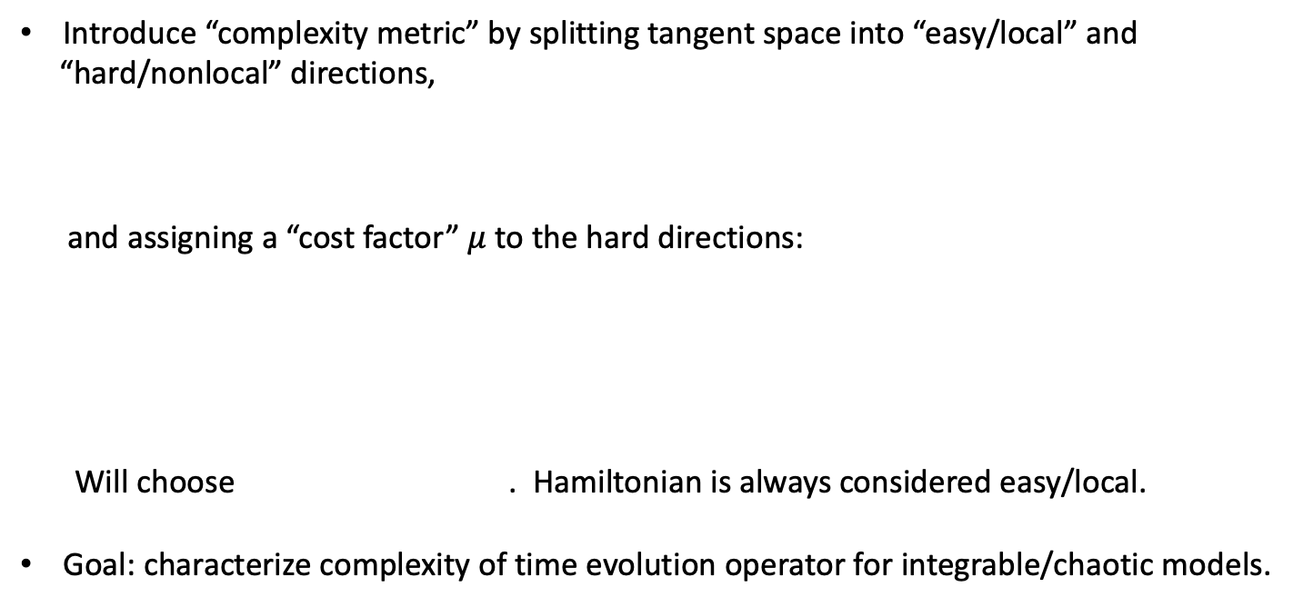
Complexity of time evolution
Introduce “complexity metric” by splitting tangent space into “easy/local” and
“hard/nonlocal” directions,
and assigning a “cost factor” $μ$ to the hard directions:
Will choose . Hamiltonian is always considered easy/local.
Goal: characterize complexity of time evolution operator for integrable/chaotic models.
[Balasubramanian, DeCross, Kar, Parrikar 2019; Balasubramanian, DeCross, Kar, Li, Parrikar 2021]

Slide 4
Outline
A bound on complexity
Complexity in quantum resonant systems
Integrability and complexity in quantum spin chains
Conclusions and outlook

Slide 5

Complexity in bi-invariant metric
Geodesics in bi-invariant metric have constant velocity $V$:
Geodesics connecting and :
with , so (if no degeneracies)
with
Complexity
Solve by choosing such that
[Balasubramanian, DeCross, Kar, Li, Parrikar 2021]

Slide 6
Early-time complexity
For early times, the shortest geodesic path is given by time evolution:
Early-time complexity:
To compare different models, perform energy shift and scaling to obtain
and
Universal early-time growth . Continues to hold with complexity metric.
Note:

Slide 7
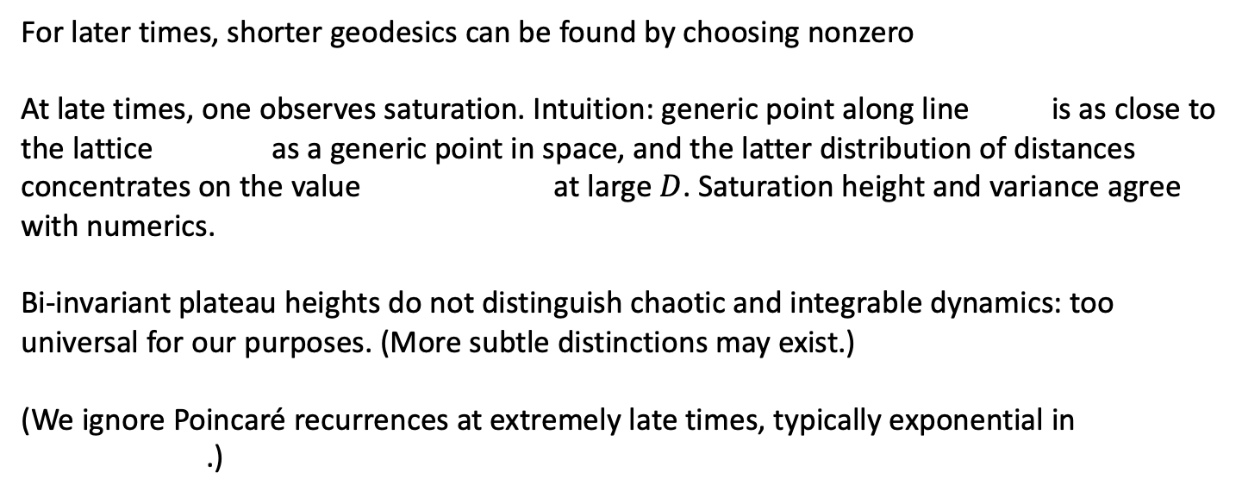
Late-time bi-invariant complexity
For later times, shorter geodesics can be found by choosing nonzero
At late times, one observes saturation. Intuition: generic point along line is as close to
the lattice as a generic point in space, and the latter distribution of distances
concentrates on the value at large $D$. Saturation height and variance agree
with numerics.
Bi-invariant plateau heights do not distinguish chaotic and integrable dynamics: too
universal for our purposes. (More subtle distinctions may exist.)
(We ignore Poincaré recurrences at extremely late times, typically exponential in
.)

Slide 8
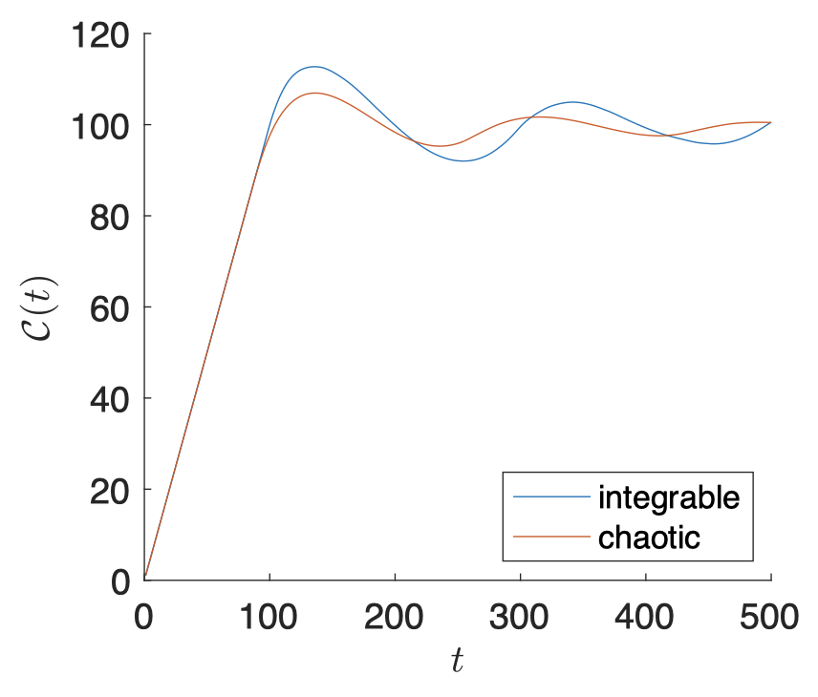
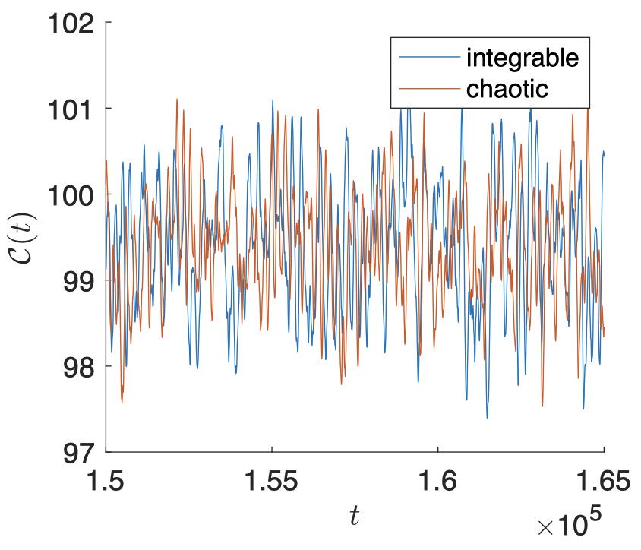
Complexity in bi-invariant metric
Bi-invariant complexity only depends on energy spectra. Compare random energy levels
(“integrable”) with eigenvalues of random matrices (“chaotic”): very similar.
[BC, De Clerck, Evnin, Hacker, Pavlov 2022]

Slide 9
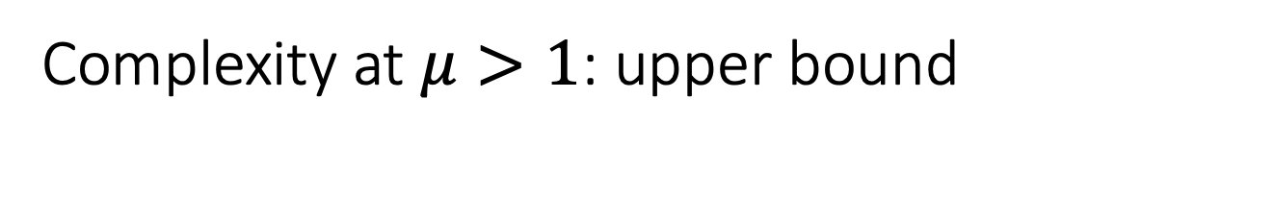
Complexity at $μ>1$: upper bound
Variational method: minimizing over all possible curves (exact solution) is too hard, so let us
minimize over bi-invariant geodesics instead. This gives a rigorous upper bound on Nielsen
complexity.
Bi-invariant geodesics are generically not geodesics of the complexity metric. This is fine.
Finding the bi-invariant geodesic with shortest length (as measured using the complexity
metric) is also too hard, but a suboptimal solution also provides a rigorous upper bound.
Question: is this bound useful?
Will show that it manages to separate chaotic from integrable time evolution.
[BC, De Clerck, Evnin, Hacker, Pavlov 2022]

Slide 10
Complexity at $μ>1$: upper bound
Minimize over bi-invariant geodesics:
with
Decompose projectors on energy eigenstates into easy and hard directions:
[BC, De Clerck, Evnin, Hacker, Pavlov 2022]

Slide 11
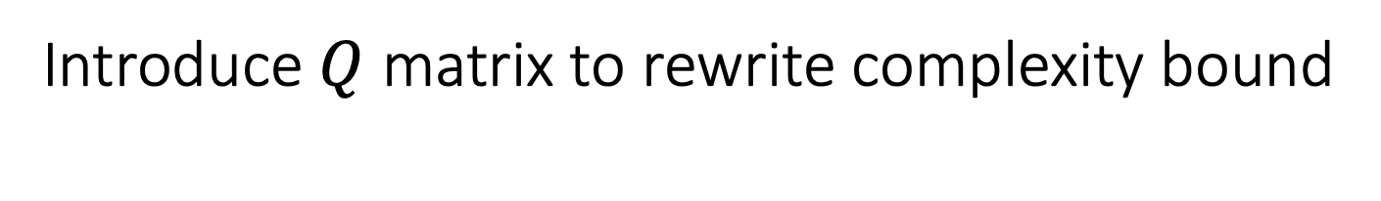
Introduce $Q$ matrix to rewrite complexity bound
with
[BC, De Clerck, Evnin, Hacker, Pavlov 2022]

Slide 12
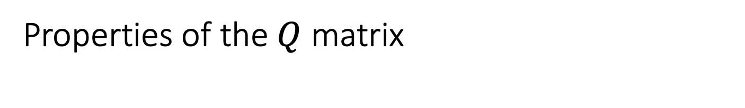
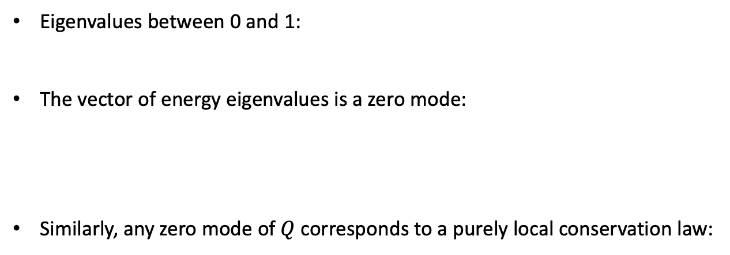
Properties of the $Q$ matrix
Eigenvalues between 0 and 1:
The vector of energy eigenvalues is a zero mode:
Similarly, any zero mode of $Q$corresponds to a purely local conservation law:
[BC, De Clerck, Evnin, Hacker, Pavlov 2022]

Slide 13
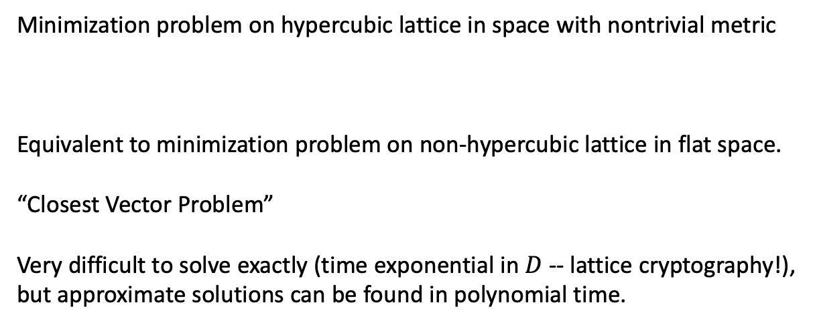
Bound on complexity as Closest Vector Problem
Minimization problem on hypercubic lattice in space with nontrivial metric
Equivalent to minimization problem on non-hypercubic lattice in flat space.
“Closest Vector Problem”
Very difficult to solve exactly (time exponential in $D$ -- lattice cryptography!),
but approximate solutions can be found in polynomial time.
[BC, De Clerck, Evnin, Hacker, Pavlov 2022]

Slide 14






Closest Vector Problem: rounding does not work
$$e_{rounded}$$
$$b_{2}$$
$$e$$
$$b_{1}$$
$e=0.6 b_{2}−$ 6 $b_{1}$
$e_{rounded}=b_{2}−$ 6 $b_{1}$
[BC, De Clerck, Evnin, Hacker, Pavlov 2022]

Slide 15
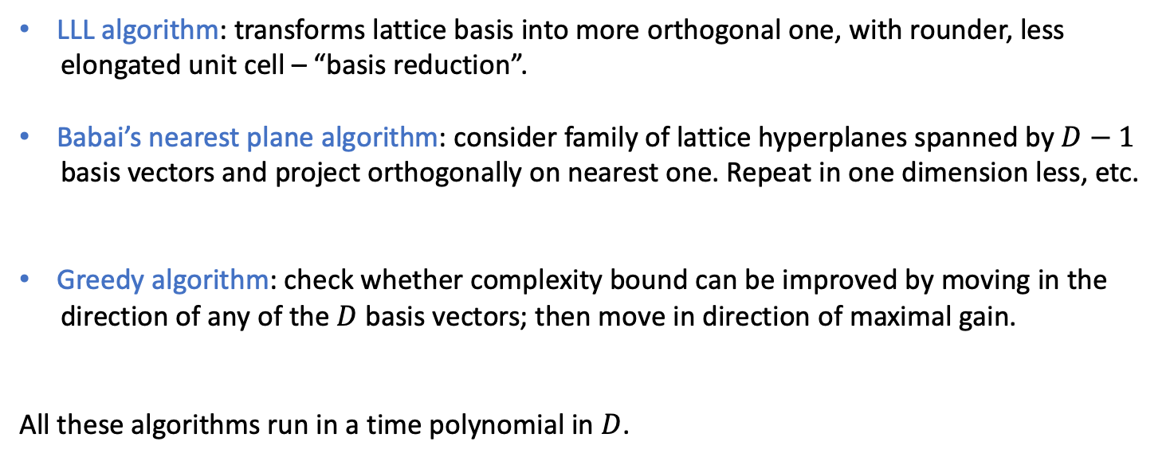
Closest Vector Problem: approximation methods
LLL algorithm: transforms lattice basis into more orthogonal one, with rounder, less
elongated unit cell – “basis reduction”.
Babai’s nearest plane algorithm: consider family of lattice hyperplanes spanned by $D−1$
basis vectors and project orthogonally on nearest one. Repeat in one dimension less, etc.
Greedy algorithm: check whether complexity bound can be improved by moving in the
direction of any of the $D$ basis vectors; then move in direction of maximal gain.
All these algorithms run in a time polynomial in $D$.
[Lenstra, Lenstra, Lovász 1982]
[Babai 1986]
[Park, Boyd 2015]
[BC, De Clerck, Evnin, Hacker, Pavlov 2022]

Slide 16
Outline
A bound on complexity
Complexity in quantum resonant systems
Integrability and complexity in quantum spin chains
Conclusions and outlook

Slide 17
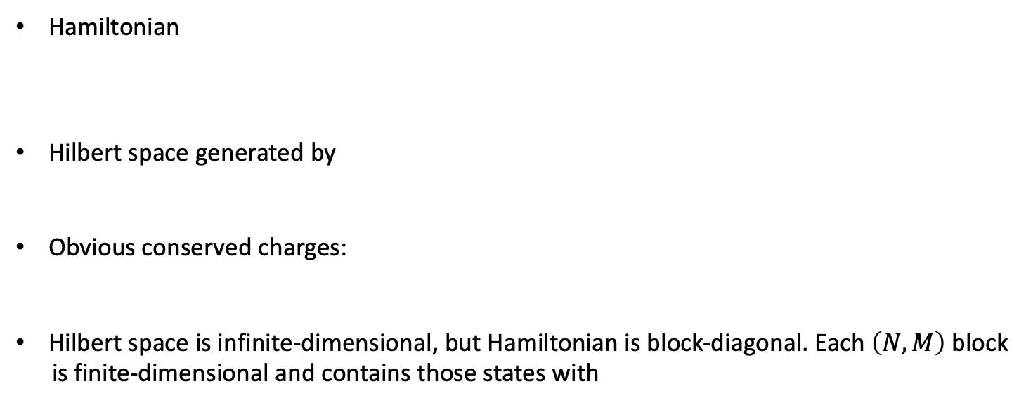
Quantum resonant systems
Hamiltonian
Hilbert space generated by
Obvious conserved charges:
Hilbert space is infinite-dimensional, but Hamiltonian is block-diagonal. Each $\left(N,M\right)$ block
is finite-dimensional and contains those states with
[Evnin, Piensuk 2019]

Slide 18
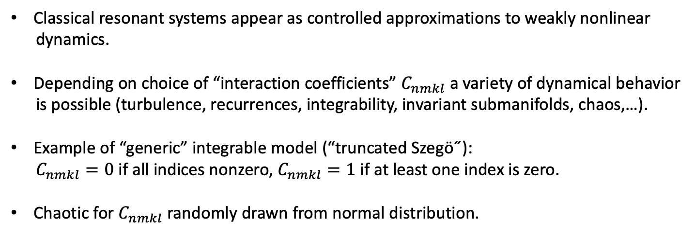
Quantum resonant systems
Classical resonant systems appear as controlled approximations to weakly nonlinear
dynamics.
Depending on choice of “interaction coefficients” $C_{nmkl}$ a variety of dynamical behavior
is possible (turbulence, recurrences, integrability, invariant submanifolds, chaos,…).
Example of “generic” integrable model (“truncated Szegö˝):
$C_{nmkl}=0$ if all indices nonzero, $C_{nmkl}=1$ if at least one index is zero.
Chaotic for $C_{nmkl}$ randomly drawn from normal distribution.
[Biasi, Evnin 2020]

Slide 19
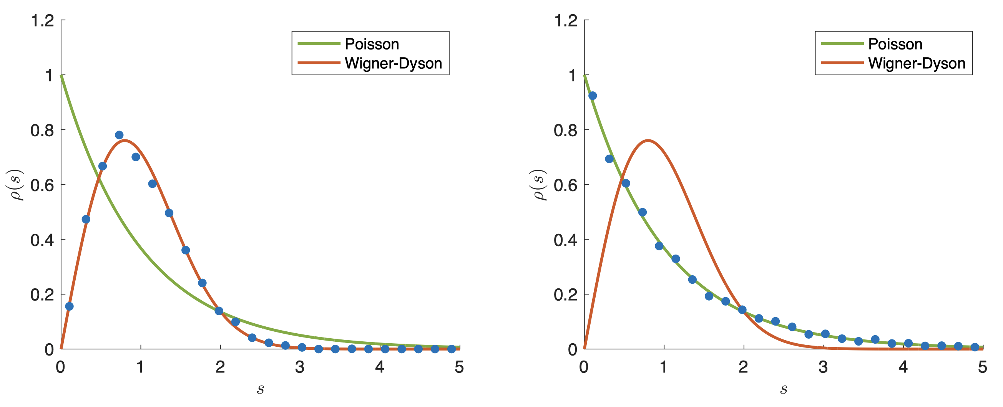


Chaotic and integrable quantum resonant systems
random
$$\left(N=30, M=30\right)$$
truncated Szegö
[BC, De Clerck, Evnin, Hacker, Pavlov 2022]
$$D=5604$$

Slide 20
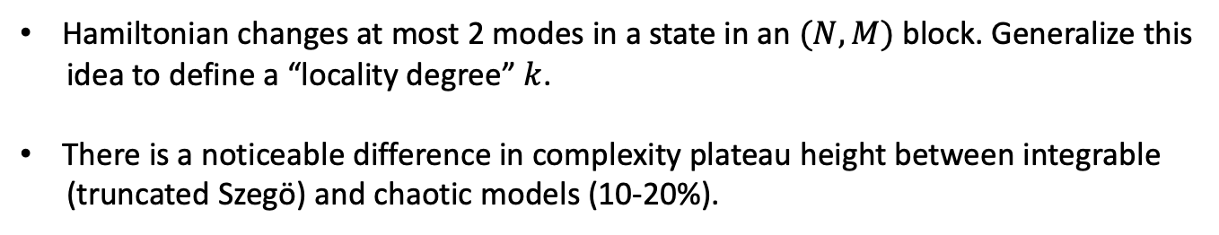
Complexity in quantum resonant systems
Hamiltonian changes at most 2 modes in a state in an $(N,M)$ block. Generalize this
idea to define a “locality degree” $k$.
There is a noticeable difference in complexity plateau height between integrable
(truncated Szegö) and chaotic models (10-20%).
[BC, De Clerck, Evnin, Hacker, Pavlov 2022]

Slide 21
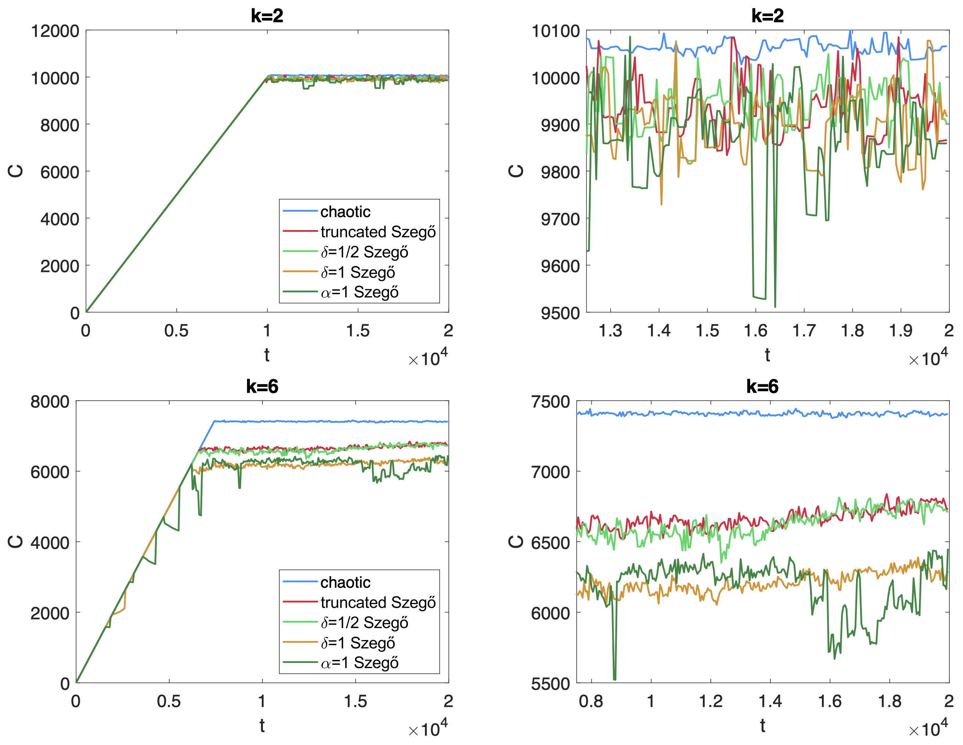


Integrable models have lower complexity
$$\left(N=30, M=30\right)$$
$$D=5604$$
[BC, De Clerck, Evnin,
Hacker, Pavlov 2022]

Slide 22
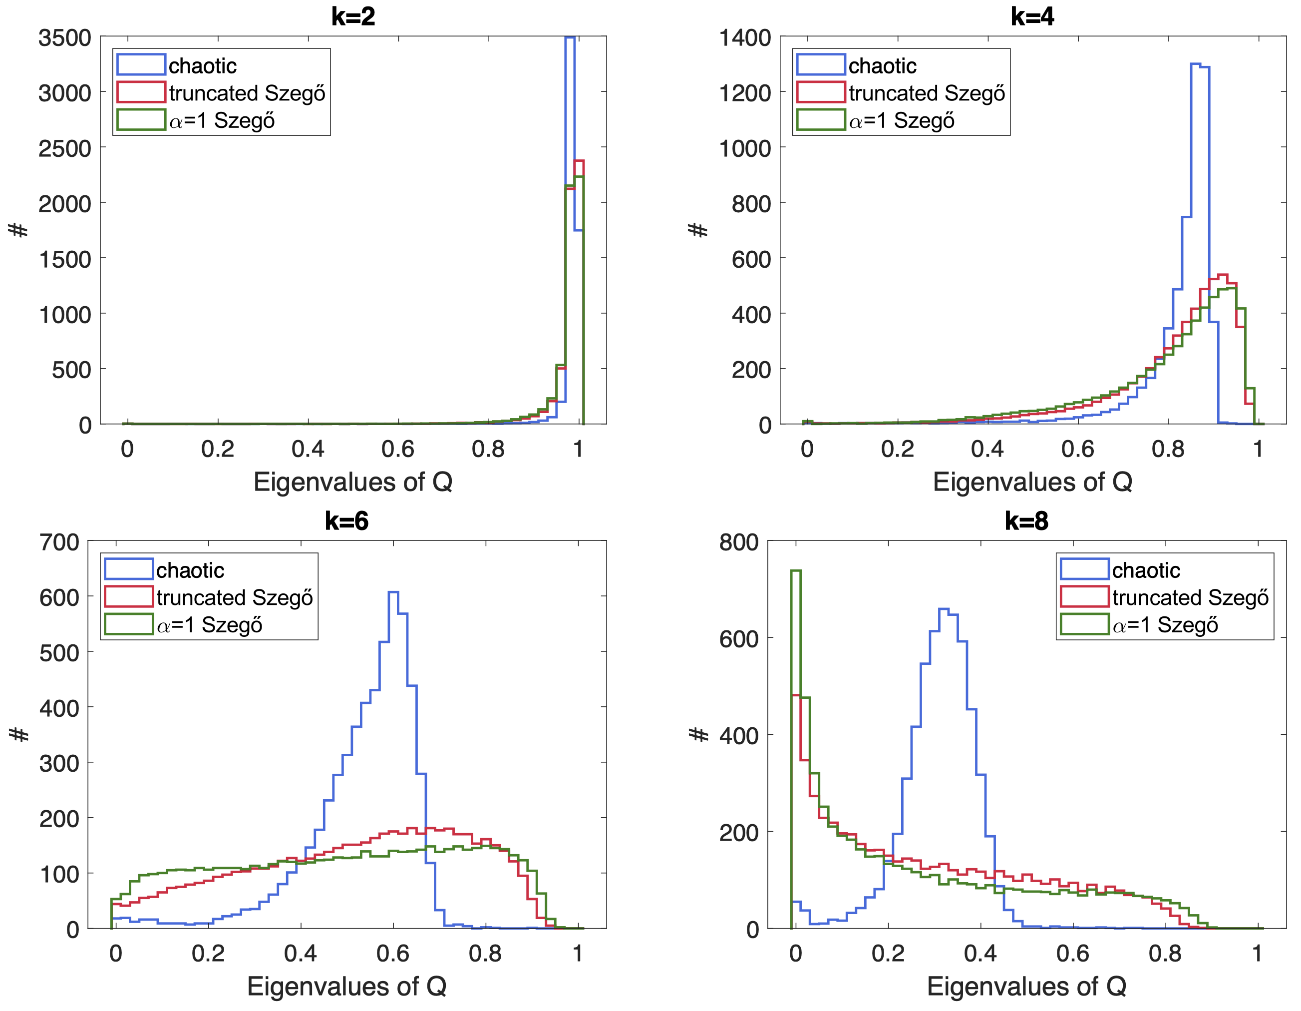
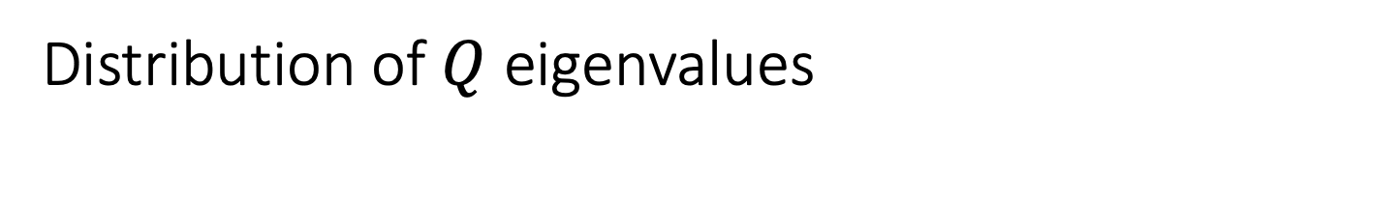
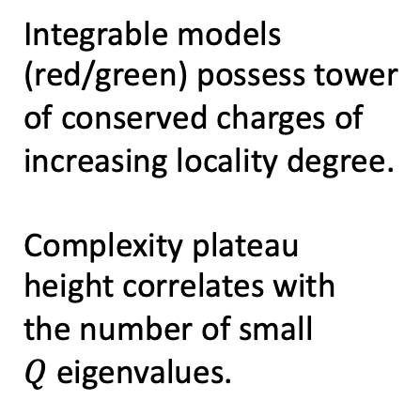


Distribution of $Q$ eigenvalues
Integrable models
(red/green) possess tower
of conserved charges of
increasing locality degree.
Complexity plateau
height correlates with
the number of small
$Q$ eigenvalues.
[BC, De Clerck, Evnin,
Hacker, Pavlov 2022]
$$\left(N=30, M=30\right)$$
$$D=5604$$

Slide 23
Outline
A bound on complexity
Complexity in quantum resonant systems
Integrability and complexity in quantum spin chains
Conclusions and outlook

Slide 24
Chaotic models: saturation value from RMT
Assume that energy eigenvectors are columns of random unitary matrix (GUE)
For large D: RMT estimate for mean Q-eigenvalue is
RMT estimate for variance:
In large D limit with fixed or fixed : Q-eigenvalues concentrate about the
mean, so Q approaches multiple of unit matrix
[BC, De Clerck,
Evnin, Hacker 2023]

Slide 25
How does integrability lower complexity?
Hypothesis: In integrable models, complexity reduction is due to null eigenvalues of Q
Null eigenvalues of Q correspond to local conservation laws, characteristic of integrable
systems → direct relation between complexity reduction and integrable structures
Will test this in detail for integrable spin chains
[BC, De Clerck, Evnin, Hacker 2023]

Slide 26
Spin chain Hamiltonians
Mixed-field Ising:
Heisenberg with magnetic field:
Both are integrable if

Slide 27
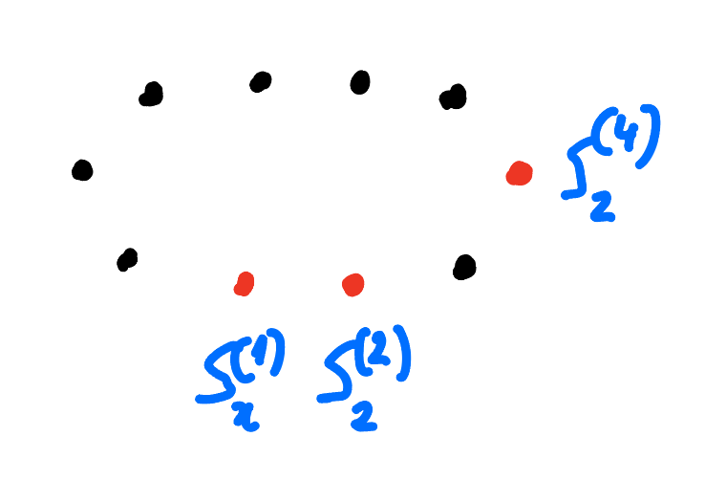
Definitions of ”easy” operators for spin chains
Unitaries are generated by strings of Pauli operators
Locality degrees:
: number of sites on which generator acts = number of Pauli operators
: length of lattice region on which generator acts nontrivially
Example: has
and
[BC, De Clerck, Evnin, Hacker 2023]

Slide 28
Integrable spin chain: towers of local conserved charges
E.g. transverse-field Ising:

Slide 29
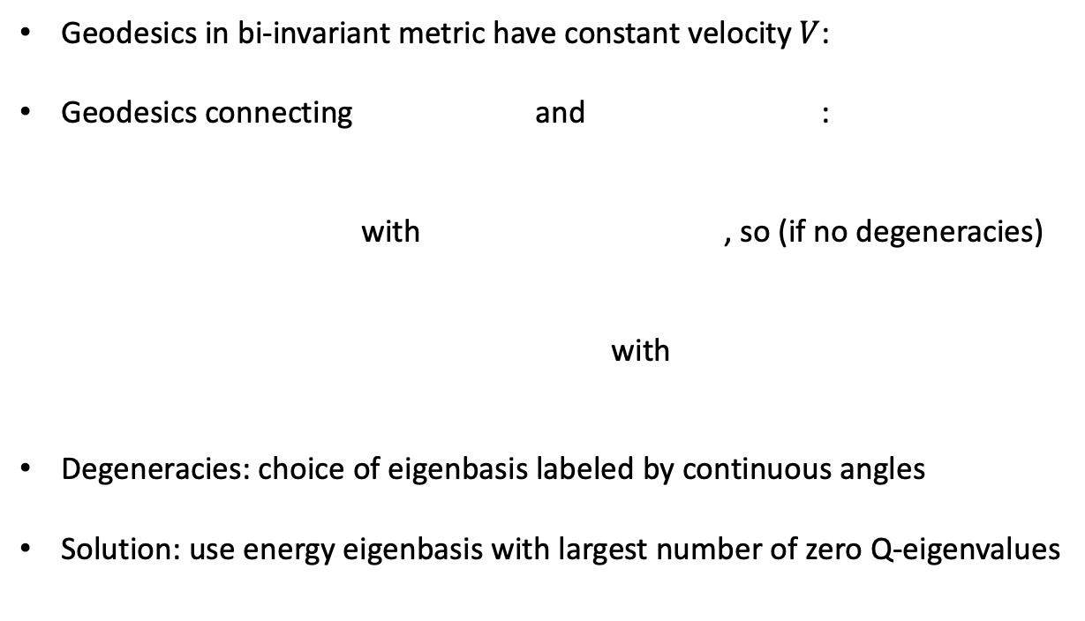
Bound on complexity for degenerate energy spectra
Geodesics in bi-invariant metric have constant velocity $V$:
Geodesics connecting and :
with , so (if no degeneracies)
with
Degeneracies: choice of eigenbasis labeled by continuous angles
Solution: use energy eigenbasis with largest number of zero Q-eigenvalues
[BC, De Clerck, Evnin, Hacker 2023]

Slide 30
Testing the complexity reduction hypothesis
For Ising and Heisenberg XYZ Hamiltonians: study correlation between complexity reduction
and various choices of the set of local/easy operators.
Predictions:
adding non-Q-kernel easy operators does not change complexity reduction much
declaring a local conservation law to become nonlocal does increases the complexity
plateau significantly
[BC, De Clerck, Evnin, Hacker 2023]

Slide 31
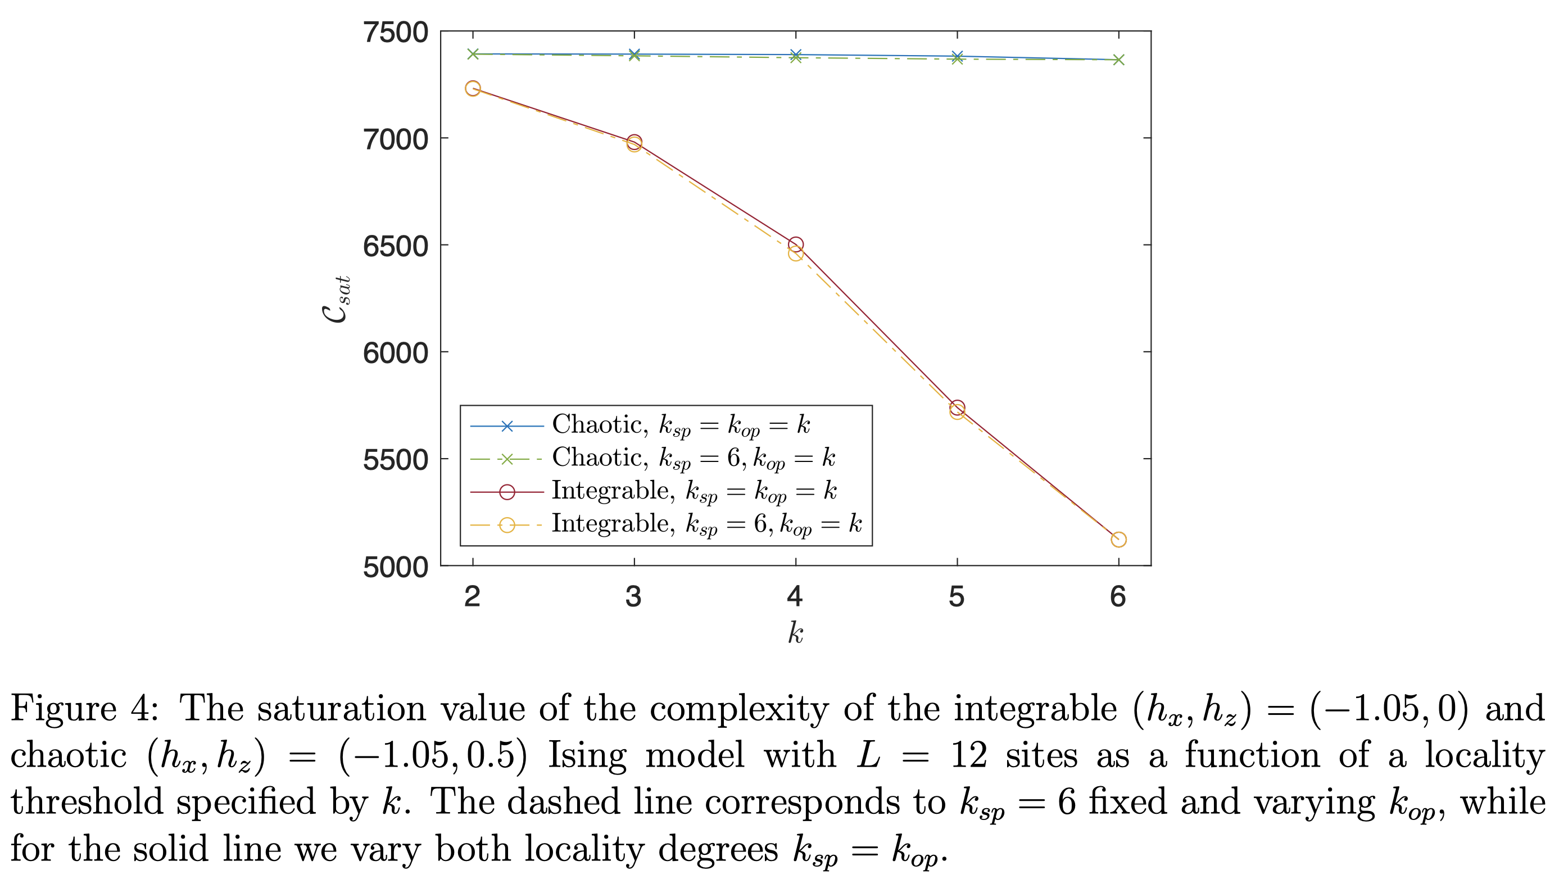
Additional non-Q-kernel “easy” operators: Ising
[BC, De Clerck, Evnin, Hacker 2023]

Slide 32
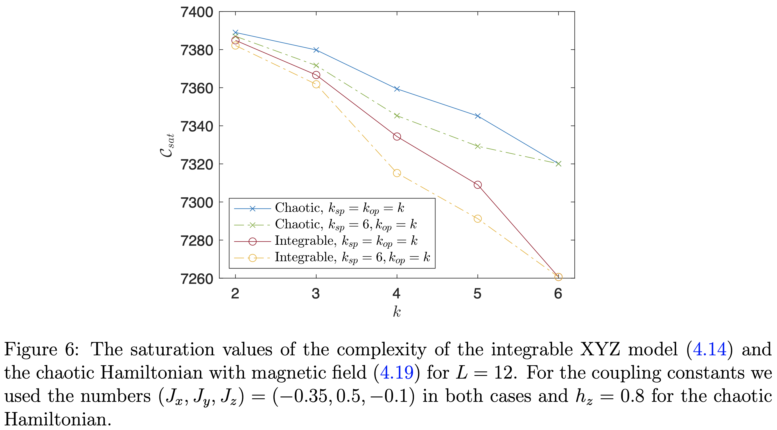
Additional non-Q-kernel “easy” operators: XYZ
[BC, De Clerck, Evnin, Hacker 2023]

Slide 33
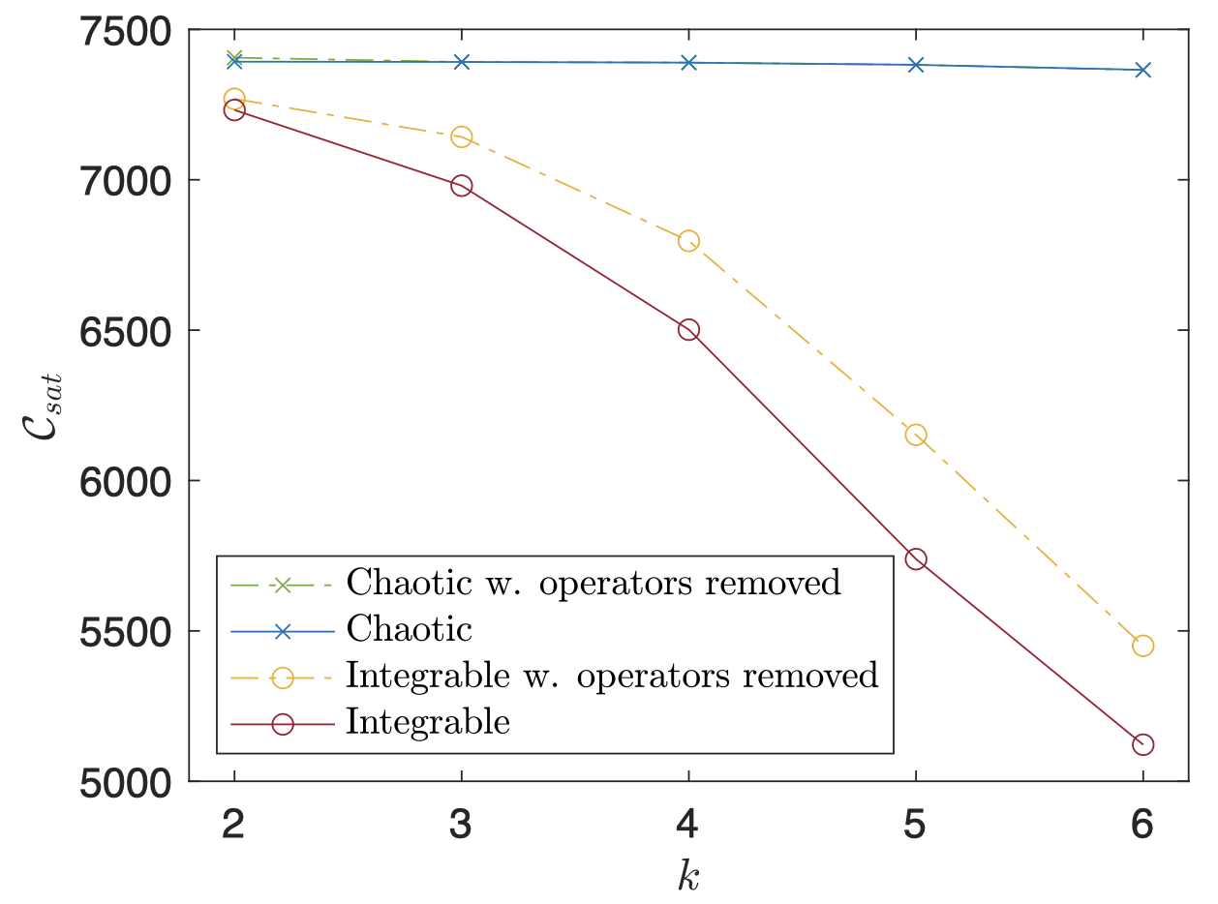
Slightly decreasing the kernel of Q: Ising
[BC, De Clerck, Evnin, Hacker 2023]

Slide 34
Outline
A bound on complexity
Complexity in quantum resonant systems
Integrability and complexity in quantum spin chains
Conclusions and outlook

Slide 35
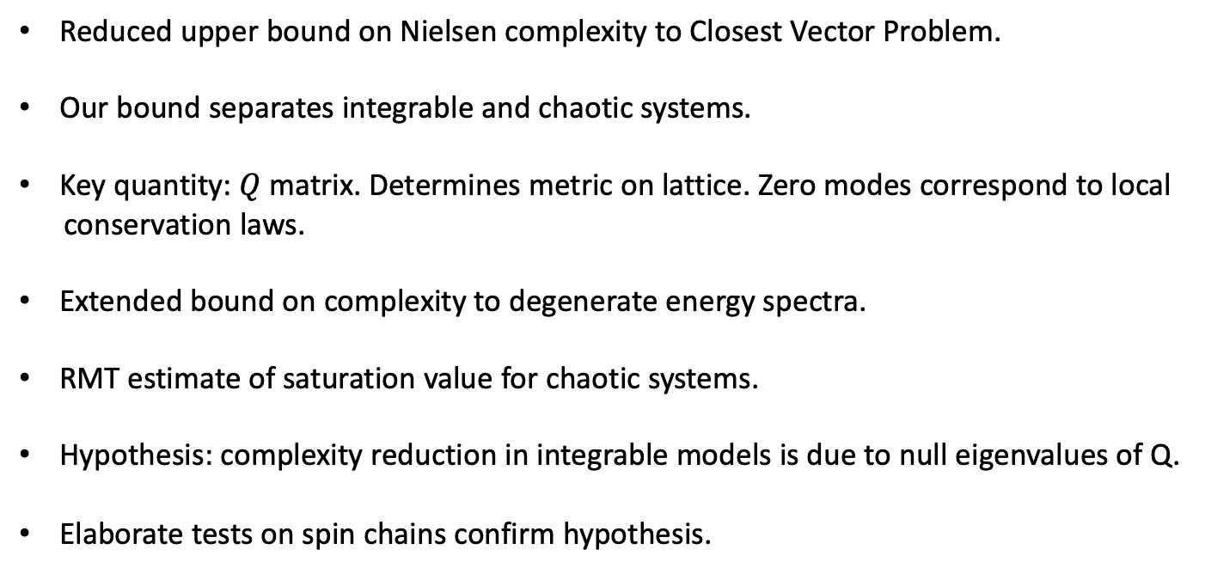
Conclusions
Reduced upper bound on Nielsen complexity to Closest Vector Problem.
Our bound separates integrable and chaotic systems.
Key quantity: $Q$ matrix. Determines metric on lattice. Zero modes correspond to local
conservation laws.
Extended bound on complexity to degenerate energy spectra.
RMT estimate of saturation value for chaotic systems.
Hypothesis: complexity reduction in integrable models is due to null eigenvalues of Q.
Elaborate tests on spin chains confirm hypothesis.
[BC, De Clerck, Evnin, Hacker, Pavlov 2022]
[BC, De Clerck, Evnin, Hacker 2023]

Slide 36
Outlook
Complexity plateau height from average distance to lattice: extend to integrable systems?
Are there simple improvements of our bound? Paths with piecewise constant velocities?
To which geodesics do our simple curves flow?
Limit of large penalty factor ?

Slide 38
SYK models
Free SYK:
Interacting integrable SYK:
Chaotic SYK:

Slide 39
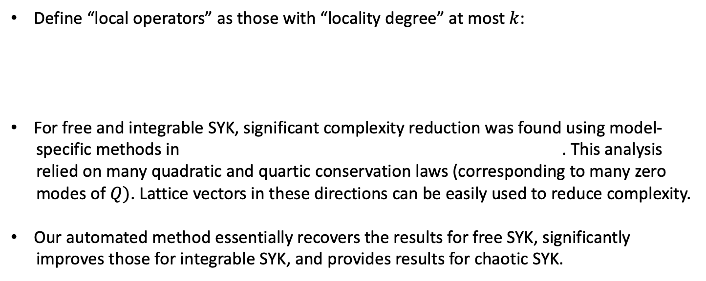
Complexity in SYK models
Define “local operators” as those with “locality degree” at most $k$:
For free and integrable SYK, significant complexity reduction was found using model-
specific methods in . This analysis
relied on many quadratic and quartic conservation laws (corresponding to many zero
modes of $Q)$. Lattice vectors in these directions can be easily used to reduce complexity.
Our automated method essentially recovers the results for free SYK, significantly
improves those for integrable SYK, and provides results for chaotic SYK.
[Balasubramanian, DeCross, Kar, Li, Parrikar 2021]
[BC, De Clerck, Evnin, Hacker, Pavlov 2022]

Slide 40
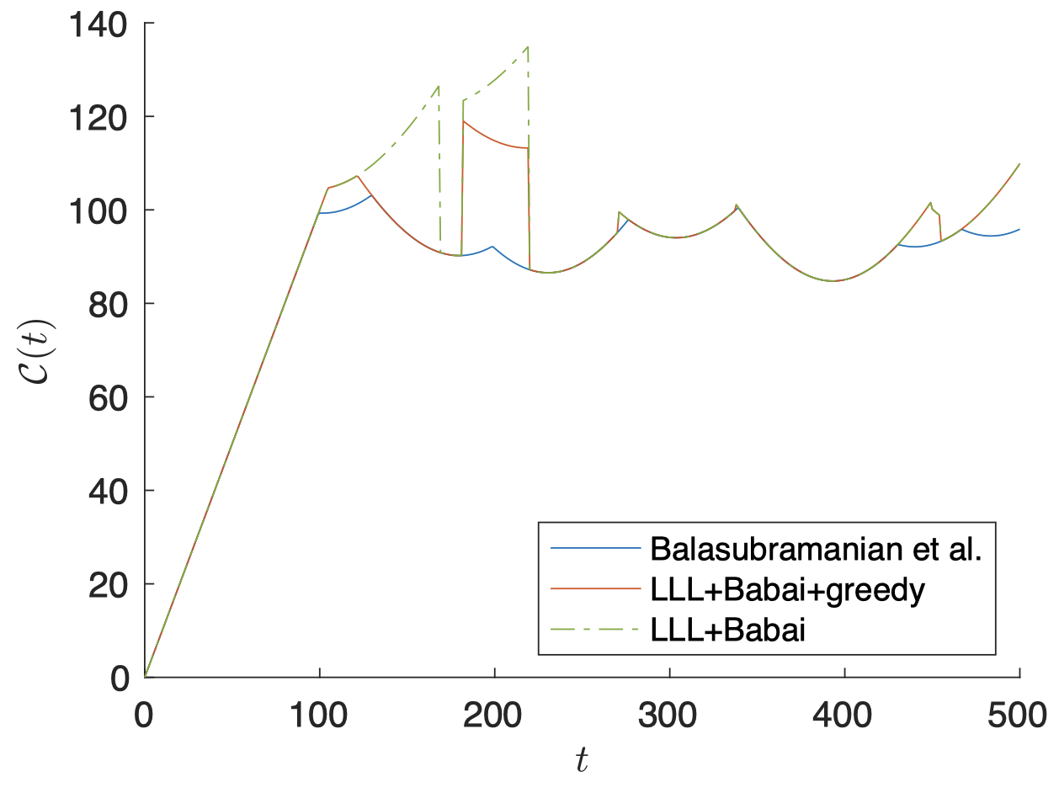
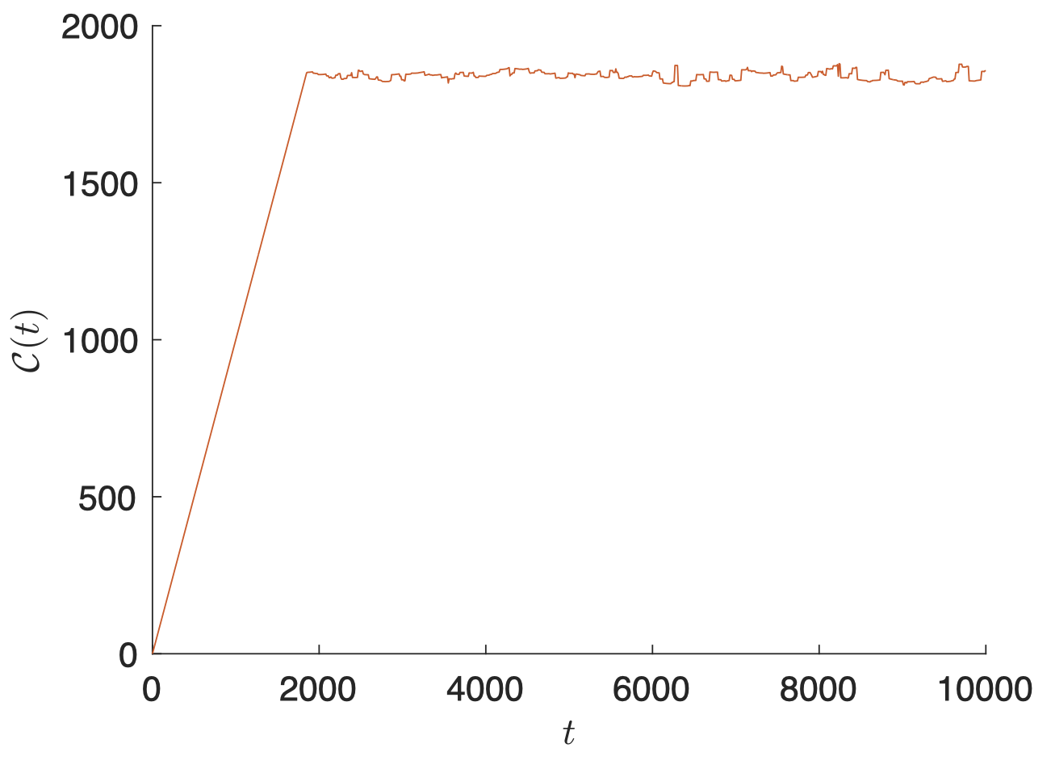
Complexity in SYK models
Free SYK
Chaotic SYK
[BC, De Clerck, Evnin, Hacker, Pavlov 2022]

Slide 41
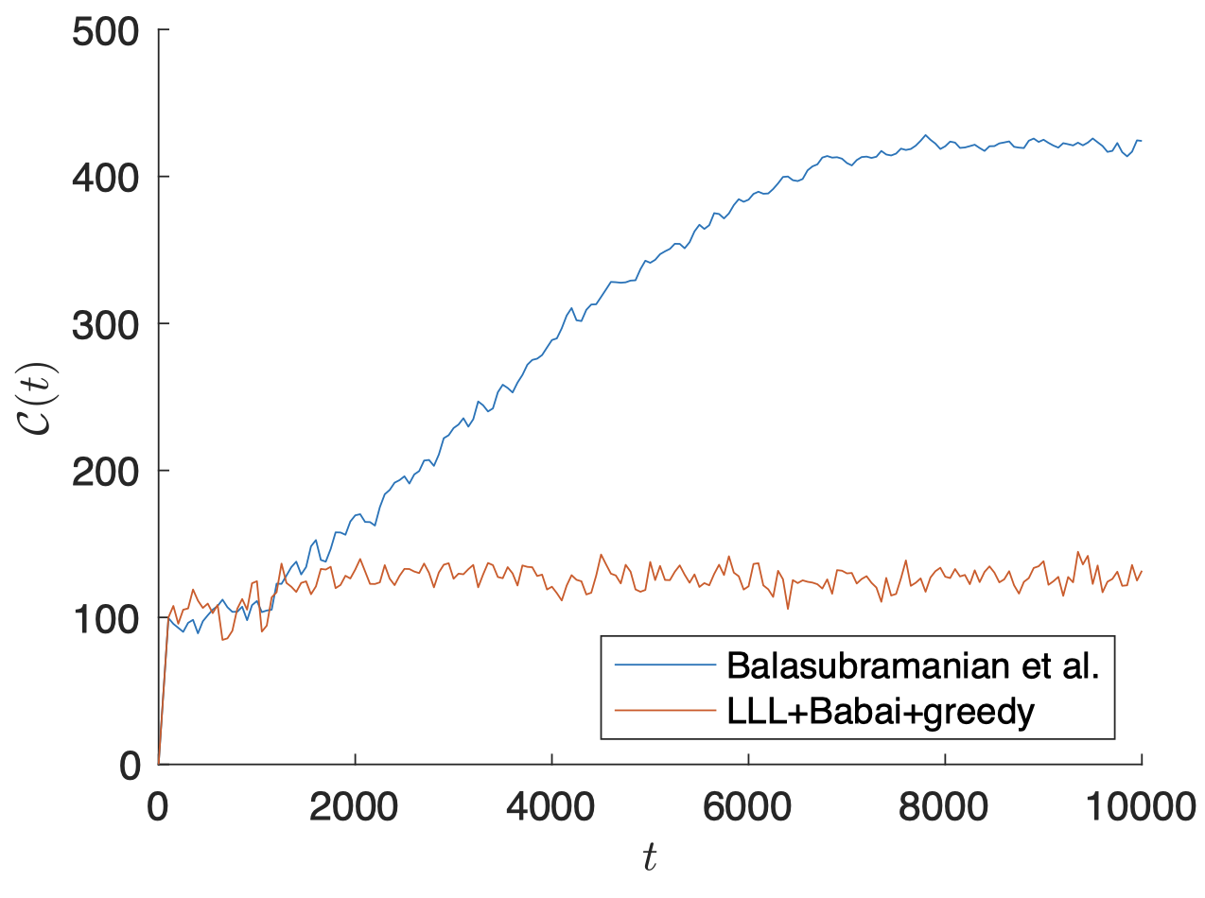
Complexity in SYK models
Integrable SYK
[BC, De Clerck, Evnin, Hacker, Pavlov 2022]

Slide 42
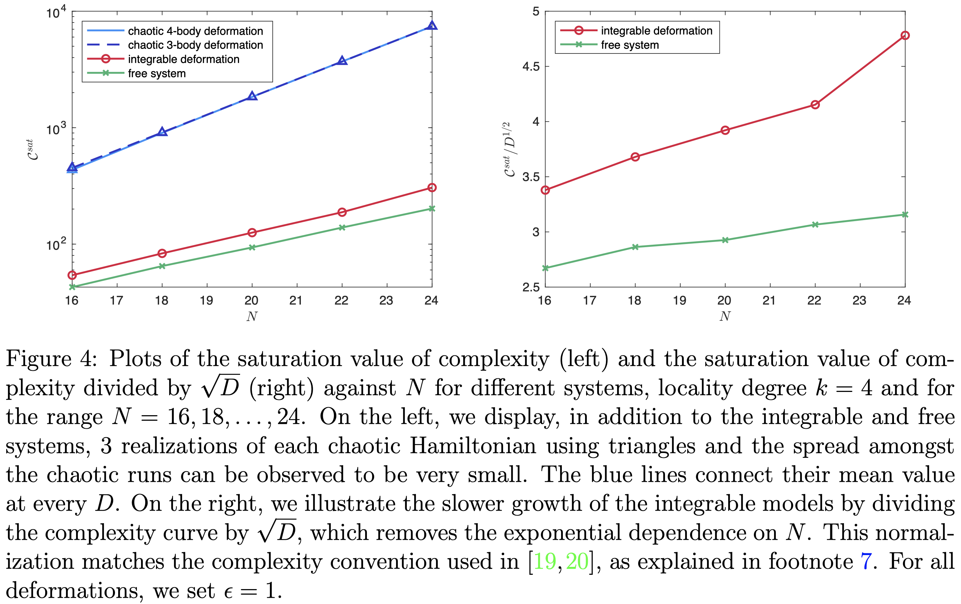
Complexity in SYK models
[BC, De Clerck, Evnin, Hacker, Pavlov 2022]

Slide 43
SYK is special
Integrable SYK is not a generic integrable system (unusually many quadratic and quartic
conservation laws, which furthermore have integer spectra).
Fermionic models have no conventional semiclassical limit, which is a drawback when
discussing chaos and integrability.

Slide 44
Complexity and black hole physics
Complexity is increasingly present in discussions of black holes:
volume behind horizon,…
difficulty of reconstructing BH interior, protection of causality
difficulty of distinguishing BH microstates
Lots of work on proposed gravitational duals. Need tools for computing complexity
in QM/QFT.
What causes black holes to be complex? Chaotic time-evolution? Does complexity
distinguish chaotic from integrable evolution?
[Susskind 2014,…]
[Harlow, Hayden 2013; Aaronson 2016; Kim, Tang, Preskill 2020,…]
[Balasubramanian, de Boer, Jejjala, Simón 2005,…]
[Brown, Susskind, Zhao 2016; Balasubramanian, DeCross, Kar, Li, Parrikar;
Rabinovici, Sánchez-Garrido, Shir, Sonner;…]

